Slide 1







Managing
Multihoming
Workers in the
Gig Economy
Park Sinchaisri
UC Berkeley
joint work with Gad Allon, Maxime Cohen, Ken Moon
2021 INFORMS Annual Meeting

Slide 2


Slide 3
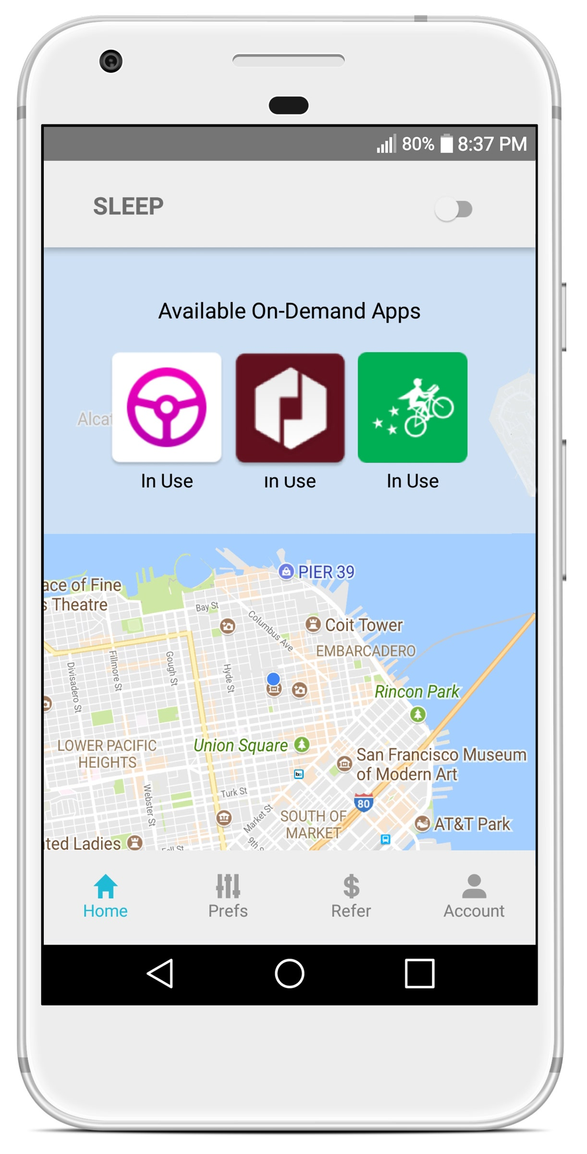








“Multihoming”
Notes:
You may have seen your ride-hailing driver having all the other apps up there to see the best opportunity and switching in real time. The behavior is usually called “multihoming”. [CLICK]
It’s getting more intense in cities like New York, where in 2018, the City Council voted to stop issuing new licenses for ride-hailing drivers for a year, and extended for another year. This means that gig companies will have to fight over the limited pool of workers.
As a growing number of platforms access the same pool of workers to complete their gigs, the question of how workers choose between competing platforms has grown in salience. However, cross-platform multihoming behavior has been difficult to empirically trace and analyze.

Slide 4
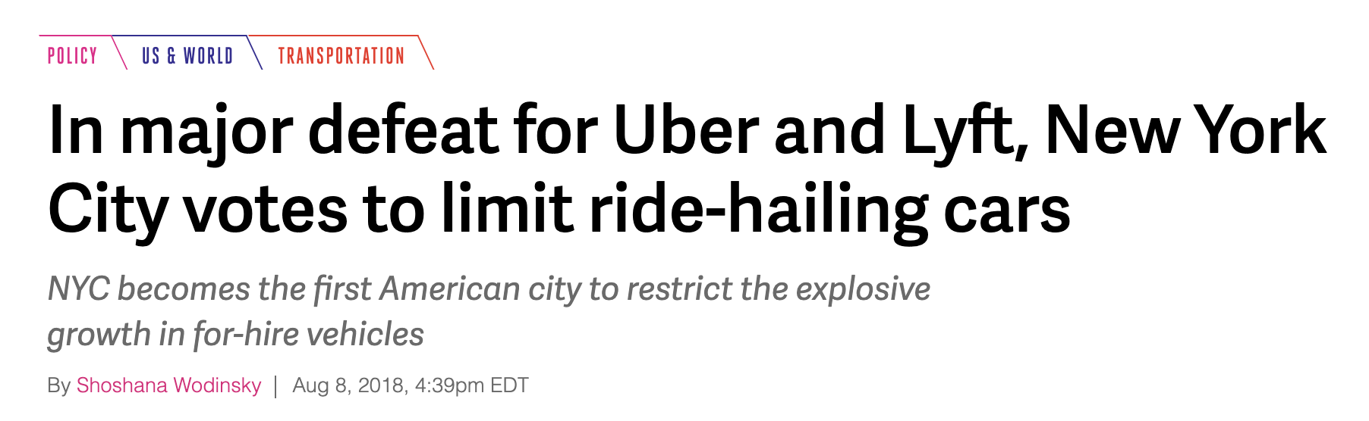
Recruiting Workers is Hard
“Multihoming”
https://www.theverge.com/2018/8/8/17661374/uber-lyft-nyc-cap-vote-city-council-new-york-taxi
Notes:
You may have seen your ride-hailing driver having all the other apps up there to see the best opportunity and switching in real time. The behavior is usually called “multihoming”. [CLICK]
It’s getting more intense in cities like New York, where in 2018, the City Council voted to stop issuing new licenses for ride-hailing drivers for a year, and extended for another year. This means that gig companies will have to fight over the limited pool of workers.
As a growing number of platforms access the same pool of workers to complete their gigs, the question of how workers choose between competing platforms has grown in salience. However, cross-platform multihoming behavior has been difficult to empirically trace and analyze.

Slide 5
Recruiting Workers is Hard
How workers make
multihoming decisions?
“Multihoming”
https://www.theverge.com/2018/8/8/17661374/uber-lyft-nyc-cap-vote-city-council-new-york-taxi
Notes:
You may have seen your ride-hailing driver having all the other apps up there to see the best opportunity and switching in real time. The behavior is usually called “multihoming”. [CLICK]
It’s getting more intense in cities like New York, where in 2018, the City Council voted to stop issuing new licenses for ride-hailing drivers for a year, and extended for another year. This means that gig companies will have to fight over the limited pool of workers.
As a growing number of platforms access the same pool of workers to complete their gigs, the question of how workers choose between competing platforms has grown in salience. However, cross-platform multihoming behavior has been difficult to empirically trace and analyze.

Slide 6
How workers make
multihoming decisions?
How should platforms
compete for multihoming workers?
Notes:
To answer this question, The first step is to better understand how gig workers actually make decisions.

Slide 7






Overview of Our Work
Structural Model of Decisions
Work Options -> Multihoming
ML-based Estimation
Counterfactuals
Notes:
In this work, we study gig workers' multihoming decisions by using machine learning methods to estimate a structural model from a ride-hailing firm's proprietary data combined with publicly reported trips data.
After recovering drivers' heterogeneous costs to drive, we perform a number of counterfactual analyses.
In our work, we’re developing a structural model of how gig workers make dynamic decisions when there are multiple work options depending on when and where they are. [CLICK] Modeling these options allows us to study the multihoming behavior among workers. [CLICK]
We’re taking a machine learning-based estimation approach to help us deal with computational challenges. And with the framework we have, [CLICK] we can then evaluate the impact of different policies on the workforce through our counterfactuals.
[2 minutes]

Slide 8
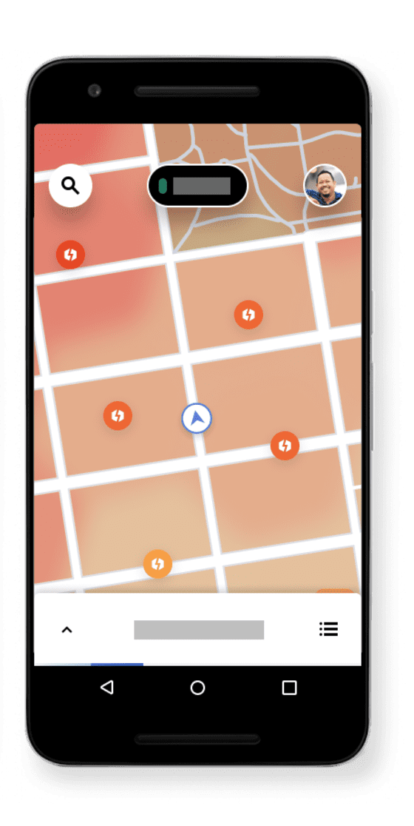
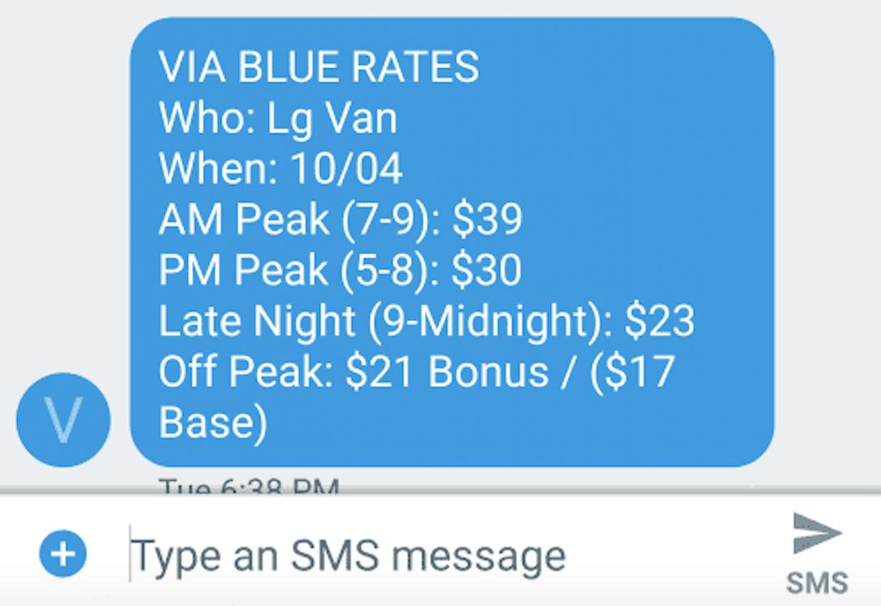
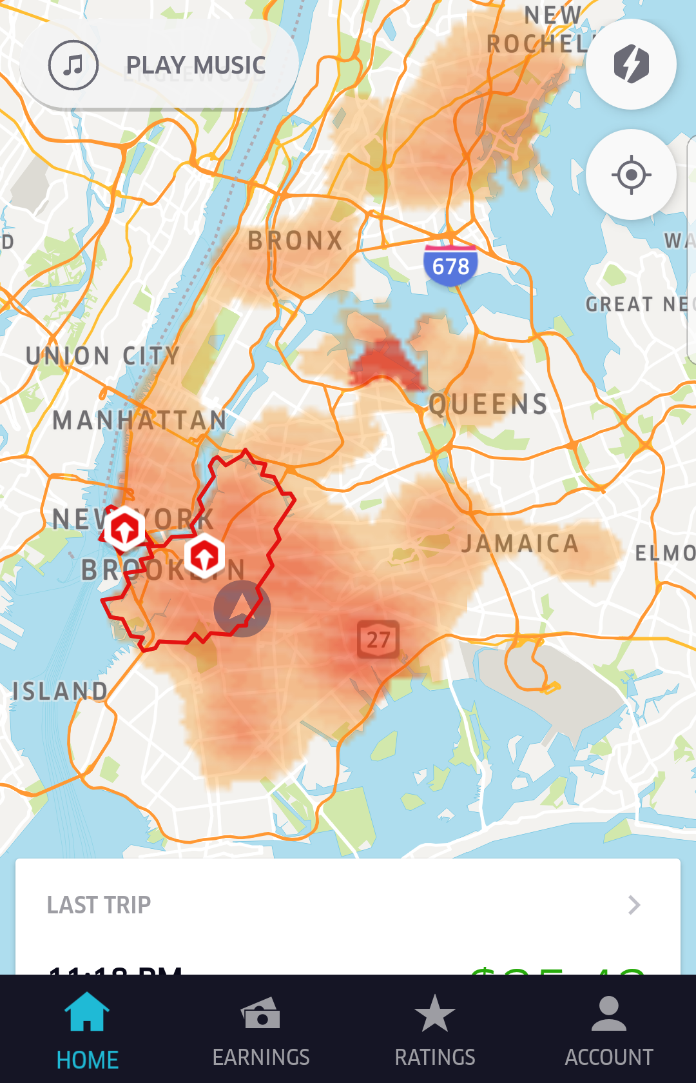
Context
Gig Workers with 2 Options
(ride-hailing platforms)
B = Competitor
A = Focal
B
A
Park S.
Notes:
We consider a setting where gig workers have two work options, which are both ride-hailing platforms.
We refer to the focal firm which is our industry partner as Firm A and the competing firm as firm B.
Quickly the difference

Slide 9


Context
Gig Workers with 2 Options
(ride-hailing platforms)
B = Competitor
A = Focal
B
A
Park S.
225 S 4th St Brooklyn, NY
8:20AM
Notes:
We consider a setting where gig workers have two work options, which are both ride-hailing platforms.
We refer to the focal firm which is our industry partner as Firm A and the competing firm as firm B.
Quickly the difference

Slide 10
Context
Gig Workers with 2 Options
(ride-hailing platforms)
B = Competitor
A = Focal
B
A
$25/hour 7-9AM
Park S.
225 S 4th St Brooklyn, NY
8:20AM
Notes:
We consider a setting where gig workers have two work options, which are both ride-hailing platforms.
We refer to the focal firm which is our industry partner as Firm A and the competing firm as firm B.
Quickly the difference

Slide 11
Context
Gig Workers with 2 Options
(ride-hailing platforms)
B = Competitor
A = Focal
B
A
$25/hour 7-9AM
Avg. Surge
+25%
Park S.
225 S 4th St Brooklyn, NY
8:20AM
Notes:
We consider a setting where gig workers have two work options, which are both ride-hailing platforms.
We refer to the focal firm which is our industry partner as Firm A and the competing firm as firm B.
Quickly the difference

Slide 12
Context
Gig Workers with 2 Options
(ride-hailing platforms)
A = Focal
A
$25/hour 7-9AM
pick-up
Park S.
18 E Broadway New York, NY
A
225 S 4th St Brooklyn, NY
8:21AM
Notes:
We consider a setting where gig workers have two work options, which are both ride-hailing platforms.
We refer to the focal firm which is our industry partner as Firm A and the competing firm as firm B.
Quickly the difference

Slide 13
Context
Gig Workers with 2 Options
(ride-hailing platforms)
A = Focal
A
$25/hour 7-9AM
drop-off
4 Berry St Brooklyn, NY
Park S.
18 E Broadway New York, NY
8:40AM
Notes:
We consider a setting where gig workers have two work options, which are both ride-hailing platforms.
We refer to the focal firm which is our industry partner as Firm A and the competing firm as firm B.
Quickly the difference

Slide 14
Context
Gig Workers with 2 Options
(ride-hailing platforms)
A = Focal
A
4 Berry St Brooklyn, NY
Park S.
9:05AM
Notes:
We consider a setting where gig workers have two work options, which are both ride-hailing platforms.
We refer to the focal firm which is our industry partner as Firm A and the competing firm as firm B.
Quickly the difference

Slide 15
Context
Gig Workers with 2 Options
(ride-hailing platforms)
A = Focal
A
$15/hour 9-11AM
4 Berry St Brooklyn, NY
Park S.
9:05AM
Notes:
We consider a setting where gig workers have two work options, which are both ride-hailing platforms.
We refer to the focal firm which is our industry partner as Firm A and the competing firm as firm B.
Quickly the difference

Slide 16
Context
Gig Workers with 2 Options
(ride-hailing platforms)
B = Competitor
A = Focal
B
A
$15/hour 9-11AM
4 Berry St Brooklyn, NY
Avg. Surge
+75%
Park S.
9:05AM
Notes:
We consider a setting where gig workers have two work options, which are both ride-hailing platforms.
We refer to the focal firm which is our industry partner as Firm A and the competing firm as firm B.
Quickly the difference

Slide 17
Context
Gig Workers with 2 Options
(ride-hailing platforms)
B = Competitor
A = Focal
B
A
$15/hour 9-11AM
B
4 Berry St Brooklyn, NY
Avg. Surge
+75%
Park S.
9:05AM
Notes:
We consider a setting where gig workers have two work options, which are both ride-hailing platforms.
We refer to the focal firm which is our industry partner as Firm A and the competing firm as firm B.
Quickly the difference

Slide 18
Context
Gig Workers with 2 Options
(ride-hailing platforms)
B = Competitor
A = Focal
B
A
July – Sep 2017, NYC
140k work sessions (consecutive online w/o breaks)
3805 drivers
Time and location of first pick-up and last drop-off
Guaranteed hourly pay
Notes:
We’re leveraging two large datasets.
First, we have a data from our ride-hailing partner. For three months in 2017, we observe information about drivers’ work sessions, which are times they continuously work without a break. We know about their first and last trips for the session. [NEXT]
We then combine this with trip records data collected by the Taxi and Limousine commission in New York. They have platform ID but not driver ID, time and location of every trip done by every platform.
We also take price breakdowns from B's website to help us approximate prices for these trips.

Slide 19

Context
Gig Workers with 2 Options
(ride-hailing platforms)
B = Competitor
A = Focal
B
A
July – Sep 2017, NYC
140k work sessions (consecutive online w/o breaks)
3805 drivers
Time and location of first pick-up and last drop-off
Guaranteed hourly pay
Trip records data
35M ride-hailing trips
Platform ID
Time and location of every pick-up/drop-off
Price breakdowns
Pay per work
B
Notes:
We’re leveraging two large datasets.
First, we have a data from our ride-hailing partner. For three months in 2017, we observe information about drivers’ work sessions, which are times they continuously work without a break. We know about their first and last trips for the session. [NEXT]
We then combine this with trip records data collected by the Taxi and Limousine commission in New York. They have platform ID but not driver ID, time and location of every trip done by every platform.
We also take price breakdowns from B's website to help us approximate prices for these trips.

Slide 20
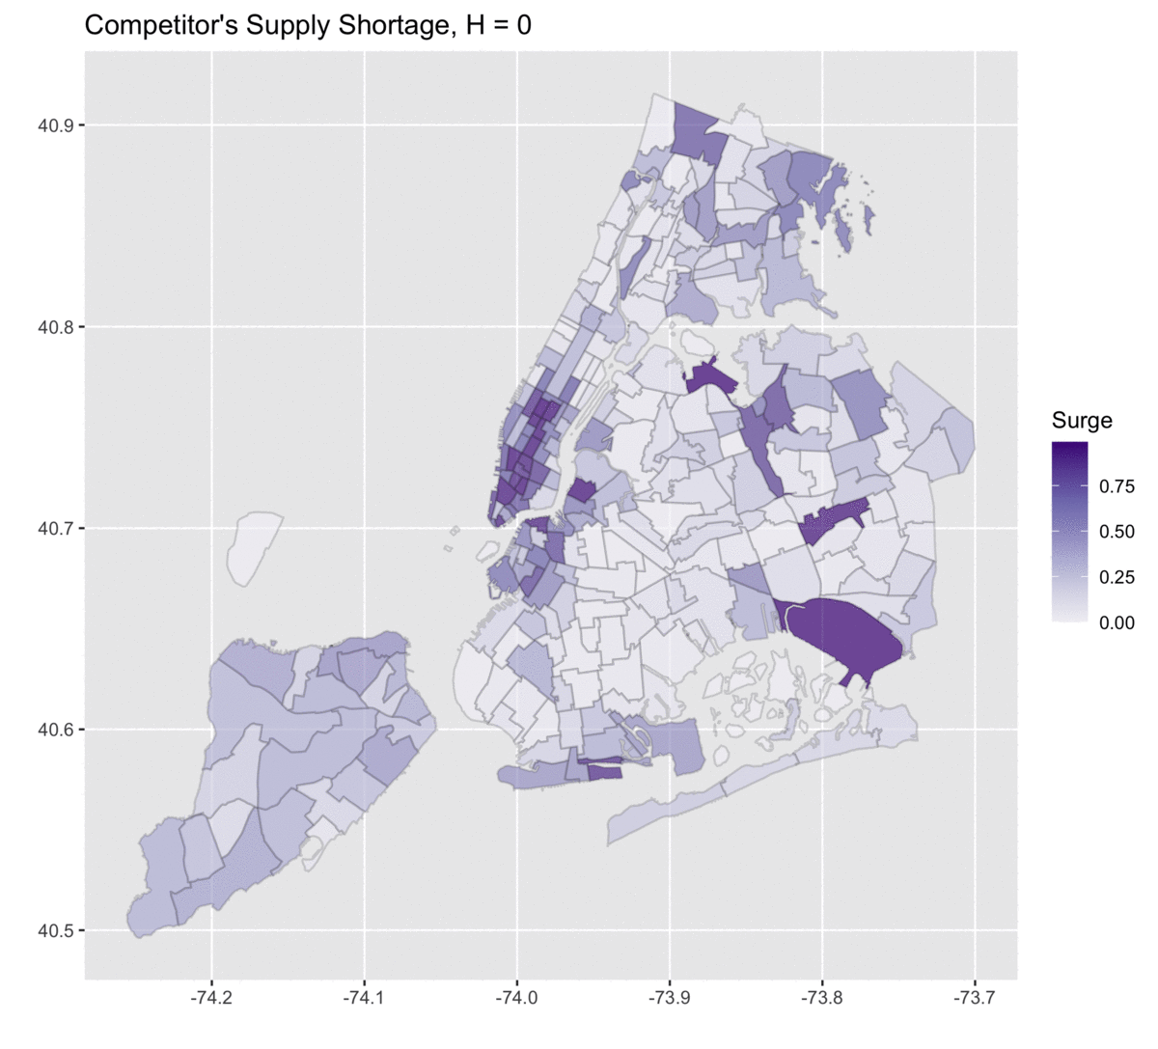
Temporal/Spatial Variations
P(Supply shortage on competitor)
B
Notes:
With these datasets, we can look at how time and location play a role in the market conditions and in workers’ decisions. On the left, we have how likely there would be a supply shortage at the competing firm, which may indicate a potential surge pricing there.
On the right, how likely drivers on A are to quit working at each location and time.
Our identification strategy, to explain the right map by the left map, relies on these temporal and spatial variations of the values of working for both platforms.

Slide 21
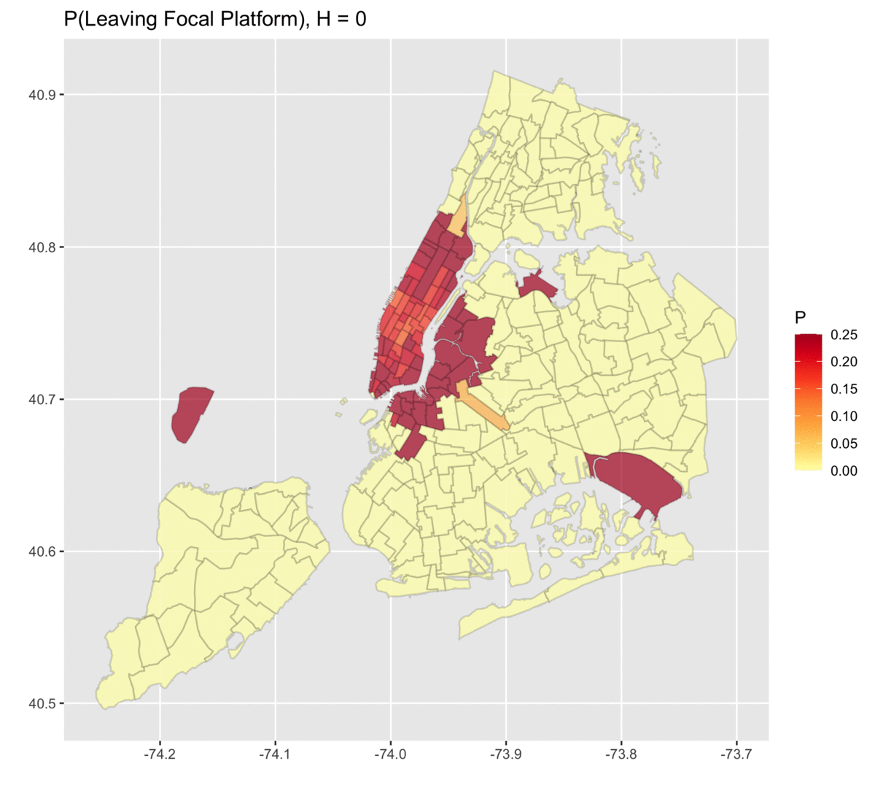
Temporal/Spatial Variations
P(Supply shortage on competitor)
P(Leaving focal firm)
B
A
Notes:
With these datasets, we can look at how time and location play a role in the market conditions and in workers’ decisions. On the left, we have how likely there would be a supply shortage at the competing firm, which may indicate a potential surge pricing there.
On the right, how likely drivers on A are to quit working at each location and time.
Our identification strategy, to explain the right map by the left map, relies on these temporal and spatial variations of the values of working for both platforms.

Slide 22
Structural Model + Estimation
of Dynamic Decisions
Notes:
Now I’ll first introduce the key parameters that characterize our ride-hailing drivers.
[5 mins]

Slide 23

Our Model
2 firms in the same industry
Finite time horizon, every 20 mins
A = Focal
Work for A
Task
Info
Notes:
We start with a worker who chose to work for A [CLICK] and then they would be working on a task. [CLICK] Then, they can decide whether to stay with the focal platform, switch over to B, or leaving the market.
If the worker chooses to switch from A to B, then they enter a similar model with the task and the decisions. For today’s talk, we assume that once the worker left A for B, they won’t return back to A. This is what we observed from our data and from talking to the drivers in NY
we’ll start modeling the competing platform first.
[they tend to drive one long session for firm A rather than doing multiple shorter sessions.]

Slide 24
Our Model
2 firms in the same industry
Finite time horizon, every 20 mins
A = Focal
Stay with A
Work for A
Decide
Task
Info
Notes:
We start with a worker who chose to work for A [CLICK] and then they would be working on a task. [CLICK] Then, they can decide whether to stay with the focal platform, switch over to B, or leaving the market.
If the worker chooses to switch from A to B, then they enter a similar model with the task and the decisions. For today’s talk, we assume that once the worker left A for B, they won’t return back to A. This is what we observed from our data and from talking to the drivers in NY
we’ll start modeling the competing platform first.
[they tend to drive one long session for firm A rather than doing multiple shorter sessions.]

Slide 25
Our Model
2 firms in the same industry
Finite time horizon, every 20 mins
A = Focal
Stay with A
Work for A
Decide
Task
Info
Quit
Leave market
Notes:
We start with a worker who chose to work for A [CLICK] and then they would be working on a task. [CLICK] Then, they can decide whether to stay with the focal platform, switch over to B, or leaving the market.
If the worker chooses to switch from A to B, then they enter a similar model with the task and the decisions. For today’s talk, we assume that once the worker left A for B, they won’t return back to A. This is what we observed from our data and from talking to the drivers in NY
we’ll start modeling the competing platform first.
[they tend to drive one long session for firm A rather than doing multiple shorter sessions.]

Slide 26
Our Model
2 firms in the same industry
Finite time horizon, every 20 mins
A = Focal
B = Competitor
Stay with A
Work for A
Decide
Task
Switch to B
Task
Info
Quit
Info
Leave market
Notes:
We start with a worker who chose to work for A [CLICK] and then they would be working on a task. [CLICK] Then, they can decide whether to stay with the focal platform, switch over to B, or leaving the market.
If the worker chooses to switch from A to B, then they enter a similar model with the task and the decisions. For today’s talk, we assume that once the worker left A for B, they won’t return back to A. This is what we observed from our data and from talking to the drivers in NY
we’ll start modeling the competing platform first.
[they tend to drive one long session for firm A rather than doing multiple shorter sessions.]

Slide 27
Our Model
2 firms in the same industry
Finite time horizon, every 20 mins
A = Focal
B = Competitor
Stay with A
Stay with B
Work for A
Decide
Decide
Task
Switch to B
Task
Info
Quit
Info
Quit
Leave market
Notes:
We start with a worker who chose to work for A [CLICK] and then they would be working on a task. [CLICK] Then, they can decide whether to stay with the focal platform, switch over to B, or leaving the market.
If the worker chooses to switch from A to B, then they enter a similar model with the task and the decisions. For today’s talk, we assume that once the worker left A for B, they won’t return back to A. This is what we observed from our data and from talking to the drivers in NY
we’ll start modeling the competing platform first.
[they tend to drive one long session for firm A rather than doing multiple shorter sessions.]

Slide 28
Our Model
2 firms in the same industry
Finite time horizon, every 20 mins
A = Focal
B = Competitor
Stay with A
Stay with B
Work for A
Decide
Decide
Task
Switch to B
Task
Info
Quit
Info
Quit
Leave market
Notes:
We start with a worker who chose to work for A [CLICK] and then they would be working on a task. [CLICK] Then, they can decide whether to stay with the focal platform, switch over to B, or leaving the market.
If the worker chooses to switch from A to B, then they enter a similar model with the task and the decisions. For today’s talk, we assume that once the worker left A for B, they won’t return back to A. This is what we observed from our data and from talking to the drivers in NY
we’ll start modeling the competing platform first.
[they tend to drive one long session for firm A rather than doing multiple shorter sessions.]

Slide 29
Our Model
2 firms in the same industry
Finite time horizon, every 20 mins
A = Focal
B = Competitor
Stay with A
Stay with B
Work for A
Decide
Decide
Task
Switch to B
Task
Info
V^{Aquit} = 0
Info
V^{Bquit} = 0
Leave market
Notes:
We start with a worker who chose to work for A [CLICK] and then they would be working on a task. [CLICK] Then, they can decide whether to stay with the focal platform, switch over to B, or leaving the market.
If the worker chooses to switch from A to B, then they enter a similar model with the task and the decisions. For today’s talk, we assume that once the worker left A for B, they won’t return back to A. This is what we observed from our data and from talking to the drivers in NY
we’ll start modeling the competing platform first.
[they tend to drive one long session for firm A rather than doing multiple shorter sessions.]

Slide 30
Our Model
2 firms in the same industry
Finite time horizon, every 20 mins
A = Focal
B = Competitor
cost to work
Stay with A
V^{Bwork} = -C_{i} + RβE[pay] + (1-R) βV_{t+1}
Work for A
Decide
Decide
Task
Task
match
Switch to B
no match
discount factor
Info
V^{Aquit} = 0
Info
V^{Bquit} = 0
Leave market
Notes:
We start with a worker who chose to work for A [CLICK] and then they would be working on a task. [CLICK] Then, they can decide whether to stay with the focal platform, switch over to B, or leaving the market.
If the worker chooses to switch from A to B, then they enter a similar model with the task and the decisions. For today’s talk, we assume that once the worker left A for B, they won’t return back to A. This is what we observed from our data and from talking to the drivers in NY
we’ll start modeling the competing platform first.
[they tend to drive one long session for firm A rather than doing multiple shorter sessions.]

Slide 31
Our Model
2 firms in the same industry
Finite time horizon, every 20 mins
A = Focal
B = Competitor
cost to work
Stay with A
V^{Bwork} = -C_{i} + RβE[pay] + (1-R) βV_{t+1}
Work for A
Decide
Decide
Task
Task
match
V^{Bwork}
no match
discount factor
Info
V^{Aquit} = 0
Info
V^{Bquit} = 0
Leave market
Notes:
We start with a worker who chose to work for A [CLICK] and then they would be working on a task. [CLICK] Then, they can decide whether to stay with the focal platform, switch over to B, or leaving the market.
If the worker chooses to switch from A to B, then they enter a similar model with the task and the decisions. For today’s talk, we assume that once the worker left A for B, they won’t return back to A. This is what we observed from our data and from talking to the drivers in NY
we’ll start modeling the competing platform first.
[they tend to drive one long session for firm A rather than doing multiple shorter sessions.]

Slide 32
Our Model
2 firms in the same industry
Finite time horizon, every 20 mins
A = Focal
B = Competitor
cost to work
V^{Awork} = w -C_{i} + RβE[pay] + (1-R) βV_{t+1}
cost to work
V^{Bwork} = -C_{i} + RβE[pay] + (1-R) βV_{t+1}
Work for A
Decide
Decide
Task
discount factor
Task
V^{Bwork}
discount factor
Info
V^{Aquit} = 0
Info
V^{Bquit} = 0
Leave market
Notes:
We start with a worker who chose to work for A [CLICK] and then they would be working on a task. [CLICK] Then, they can decide whether to stay with the focal platform, switch over to B, or leaving the market.
If the worker chooses to switch from A to B, then they enter a similar model with the task and the decisions. For today’s talk, we assume that once the worker left A for B, they won’t return back to A. This is what we observed from our data and from talking to the drivers in NY
we’ll start modeling the competing platform first.
[they tend to drive one long session for firm A rather than doing multiple shorter sessions.]

Slide 33

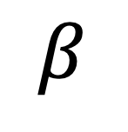
Our Model
Drivers’ Parameters
$$β$$
homogeneous
discount / forward-looking factor
heterogeneous
C_{i}
cost of working for a unit time interval
C₁
C₂
C₃
C₄
~ Truncated Normal (𝜇,𝜎²)
Notes:
We first assume that every driver has the same discount factor beta. So, they are all the same on how forward-looking they are
We model the heterogeneity of these drivers by their individual cost of working for a unit time interval. [CLICK]
So all drivers have their own costs, and these costs are drawn from a truncated normal with parameters mu and sigma^2.
Essentially, we’re going to estimate these 3 parameters: beta, mu, and sigma.

Slide 34
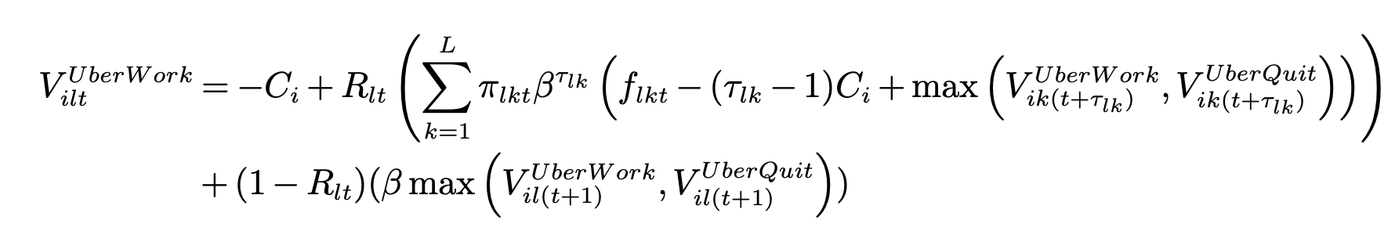
B
Working for Competing Firm
Stay with B
Decide
Task
Stop
Normalized to 0
B
Operating cost per interval (20 mins)
Notes:
First, in the value of working for B, they’d incur the cost C_i

Slide 35
B
Working for Competing Firm
B
Operating cost per interval (20 mins)
Destination realized
Trip to k
At location l, time t
Yes
Matched?
Notes:
In ride-hailing, your location is pretty much determined by whether you got a passenger. So if you get one, then you know where you will be at next and also when you will be free to make a decision again.

Slide 36
B
Working for Competing Firm
P(getting matched)
Average fare
Transition prob to destinations
Trip duration
Expected value to go if getting matched with a task (customer)
B
B
B
Destination realized
normalized to 0
Discount factor
Trip to k
At location l, time t
Yes
Matched?
Notes:
So the first component of the value is the expected value if you get matched with a customer.
This will depend on how likely you’ll get a customer, the transition matrix, the average fares and duration of the trip.

Slide 37
B
Working for Competing Firm
P(getting matched)
Average fare
Transition prob to destinations
Trip duration
Expected value to go if getting matched with a task (customer)
B
B
B
normalized to 0
Discount factor
At location l, time t
Matched?
No
Stay at l
*No relocation*
Notes:
If you don’t get a match, then you’ll still be at the same location in the next period.

Slide 38
B
Working for Competing Firm
P(getting matched)
Average fare
Transition prob to destinations
Trip duration
Expected value to go if getting matched with a task (customer)
B
B
B
B
B
Expected value to go if not getting matched with a customer
At location l, time t
Matched?
No
Stay at l
Notes:
So that is reflected in the second component here.

Slide 39
B
Working for Competing Firm
Approximated from public data
To be estimated
P(getting matched)
Average fare
Individual driver’s operating cost
Transition prob to destinations
Trip duration
Expected value to go if getting matched with a task (customer)
B
B
B
B
B
Expected value to go if not getting matched with a customer
Discount factor
To be estimated
Solve for converged discounted values for an infinite-horizon DP for every 3 hours of each day
Notes:
We break down each day into different time blocks and within each block we solve an infinite-horizon dynamic programming until convergence and then we get the expected value of working for B at each location during each time block.

Slide 40
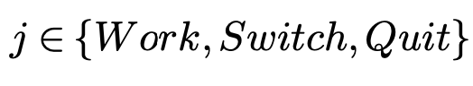
A
Working for Focal Firm
Driver chooses option
Destination realized
Trip to k
Stay
At location l, time t
Yes
Completed trip
Matched?
Earn W/hour
Decide
Switch
No
Stay at l
Quit
At t+1
Notes:
For the focal firm, it’s very similar.
Except that the workers always get paid an hourly wage as long as they’re still online. They also have 3 options now. To stay, to switch to B, or to quit and go home.

Slide 41
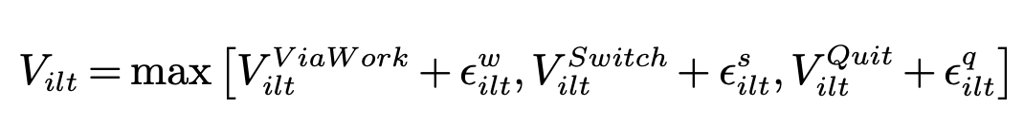
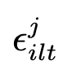
A
Working for Focal Firm
Driver chooses option
Value function at location l, time t:
Normalized to 0
A
Value of working for the focal platform
Approximated value of working for B
~ multivariate extreme value distribution
Destination realized
Trip to k
Stay
At location l, time t
Yes
Completed trip
Matched?
Earn W/hour
Decide
Switch
No
Stay at l
Quit
At t+1
Notes:
So they compare the values of the three options. Here we also allow them to choice-specific multivariate extreme value distributed errors.
The value of going home is normalized to zero, The value of switching is what solved from the competing firm model.
We now have to compute the value of working for A.

Slide 42
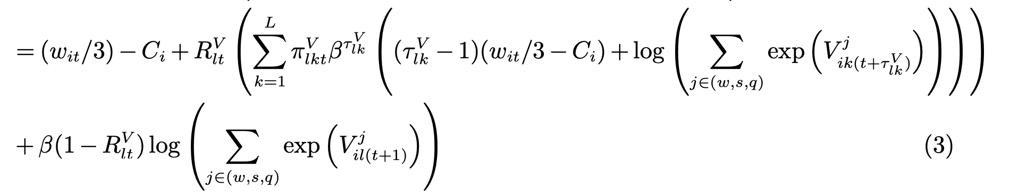
A
Working for Focal Firm
Driver chooses option
Value function at location l, time t:
A
Expected value to go if getting matched with a task (customer)
Expected value to go if not getting matched with a task (customer)
Notes:
The value of working for A is very similar to what we had before.

Slide 43
A
Working for Focal Firm
Driver chooses option
Value function at location l, time t:
A
Individual driver’s operating cost
Trip duration
Transition prob to destinations
P(getting matched)
Expected value to go if getting matched with a task (customer)
Hourly wage
Discount factor
Expected value to go if not getting matched with a task (customer)

Slide 44
A
Working for Focal Firm
To be estimated
Approximated/computed from public/proprietary data
Individual driver’s operating cost
Trip duration
Transition prob to destinations
P(getting matched)
Expected value to go if getting matched with a task (customer)
Hourly wage
A
Discount factor
Expected value to go if not getting matched with a task (customer)
To be estimated
Notes:
For this model, given the parameters, we can solve this finite horizon DP by doing backward induction, since we know all drivers leave by midnight, and we already computed the values of working for ”B”.

Slide 45

Estimation
$$β$$
discount / forward-looking factor
C_{i}
cost of working for a unit time interval
~ Truncated Normal (𝜇,𝜎²)
Notes:
These structural models are usually estimated using maximum likelihood. However, likelihood functions arising from economic models like ours are sometimes too complex to evaluate or may not exist in closed form. Here we will use simulation and ML to help.
[9 minutes here] <- AIM FOR 8 minutes

Slide 46
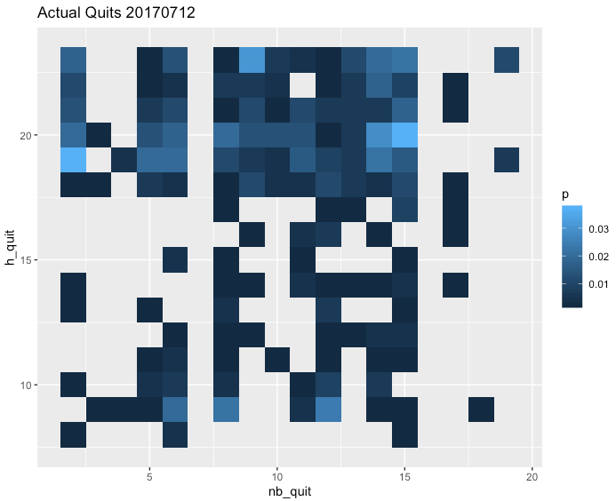
sim
Outcome of Interest
For each day, fraction of drivers quitting at (H,L)
Data
H x L
Hours: 7am to 11pm
(Remaining left at 11:59pm)
Location: 1 of 20 regions
Quitting Hour
Bronx, Brooklyn, Newark, Central Park, Chelsea, Downtown, Governors Island, Gramercy, Harlem, LES, LWS, Midtown, Morningside Heights, UES, UWS, Upper Manhattan, JFK, LaGuardia, Queens, Staten Island
Quitting location
Each cell (H,L) is fraction of drivers quitting at location L and hour H: f_{L,H}
Notes:
Here, we’re looking at what fraction of drivers who have been working for the focal firm quitting at different time and location each day. [CLICK]
H refers to the hours, from 7am to 11pm, [CLICK] and L refers to location which is one of the 20 regions in NYC. [CLICK]
Now from the actual data, we can generate a heatmap like this for each day, where each cell represents the true fraction of drivers quitting at particular time and location.

Slide 47
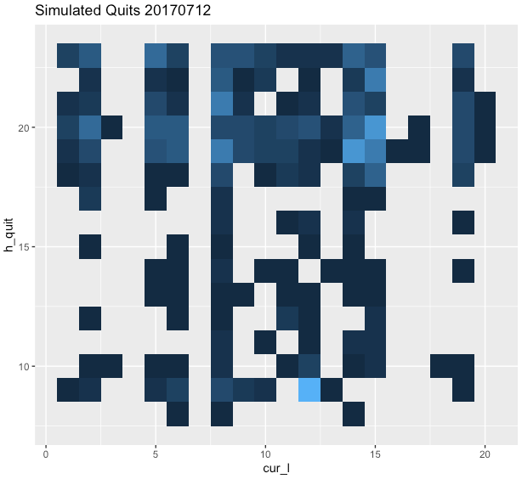

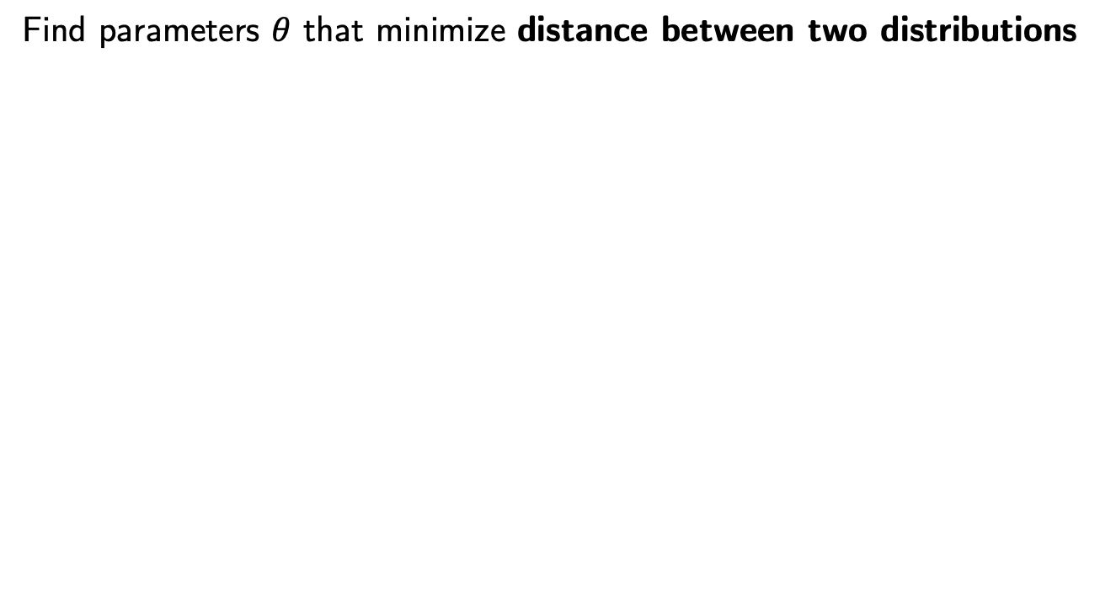
More detail at bit.ly/mmwpaper
Simulation-Assisted Estimation
Find parameters $θ$ that minimize distance between two distributions
Data
Simulation (given $θ$)
Quitting Hour
Quitting Hour
Quitting location
Quitting location
Notes:
The eventual goal is that we want to find parameters that minimize the distance function between the data and the simulation.
Many common estimation methods still suffer from the curse of dimensionality in models with rich heterogeneity and the convergence is not guaranteed or can be extremely slow.
So, we will resort to a better way to learn from data: machine learning.

Slide 48
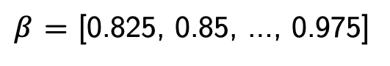
Simulating Decisions
B x C
$β$ = [0.825, 0.85, …, 0.975]
x C = [0, 0.25, …, 5]
Grid value
For each ($β$,C), simulate each driver’s decision 100 times
H x L
Distribution of quitting time and location for each driver across 100 simulations.
Day 1
Quitting Hour
Quitting location
…
H x L
Day T
Quitting Hour
Quitting location
Notes:
To help us solve computational challenges, we did a lot a lot of pre-computationfor a grid of BETA and COSTS values.
For each pair, we simulate each driver’s decision 100 times for each day. For one driver, we can generate the distribution of when and where he’s quitting across 100 runs.
We can then do the same for the rest of the days, and also for the rest of the drivers in the data.

Slide 49
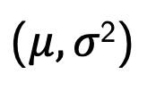
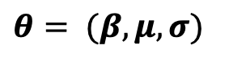
Simulating Decisions
$$θ= (β,μ,σ)$$
Draw all C_{i} from TruncatedNormal
For a given
b₁,c₂
b₂,c₂
C₁
𝛽,C₁
B x C grid of pre-computed decisions
𝛽,C₁
b₁,c₁
b₂,c₁
Notes:
In the actual simulation, given a set of parameters theta, we first draw each driver’s cost from a truncated normal with mean mu and variance sigma^2.
For the driver i with cost c_i, we revisit our pre-computed distributions. We can find the four nearest points to the pair (beta and C_i)
The new distribution of quitting decision given beta and C_i would be a linear interpolation of the four distributions associated with those four points, based on those distances.

Slide 50
Simulating Decisions
$$θ= (β,μ,σ)$$
Draw all C_{i} from TruncatedNormal
For a given
b₁,c₂
b₂,c₂
C₁
𝛽,C₁
B x C grid of pre-computed decisions
𝛽,C₁
b₁,c₁
b₂,c₁
b₁,c₁
b₁,c₂
b₂,c₁
b₂,c₂
H x L
= Linear Interpolation
H x L
H x L
H x L
H x L
(
)
Quitting Hour
Quitting location
Distributions of quitting time and location for each driver across 100 simulations.
Notes:
In the actual simulation, given a set of parameters theta, we first draw each driver’s cost from a truncated normal with mean mu and variance sigma^2.
For the driver i with cost c_i, we revisit our pre-computed distributions. We can find the four nearest points to the pair (beta and C_i)
The new distribution of quitting decision given beta and C_i would be a linear interpolation of the four distributions associated with those four points, based on those distances.

Slide 51
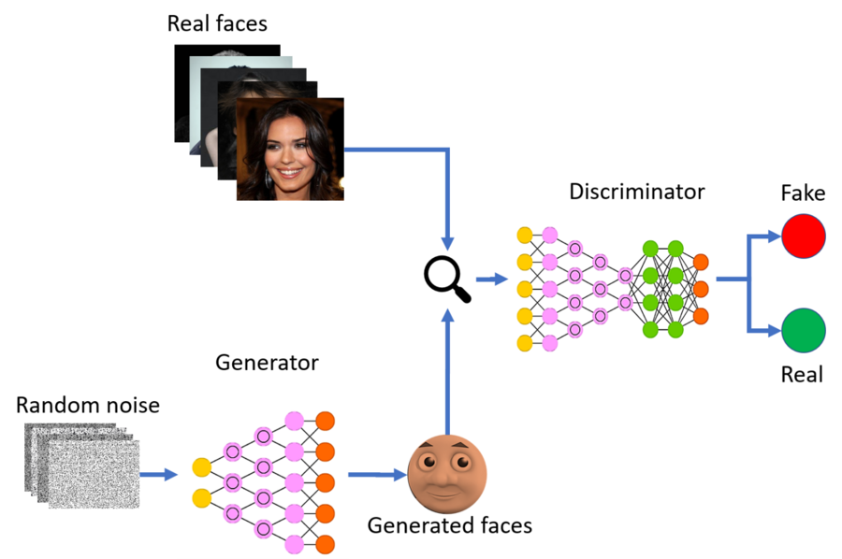
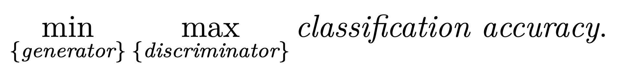
Goodfellow et al (2014)
Gen. Adversarial Networks
“D”
“G”
Notes:
the algorithm we will use is called a generative adversarial network or GAN. Its framework is a minimax game between two players over classification accuracy.
The purpose of GAN is to generate artificial data like images that look real. Our goal here is to obtain estimates of structural model that can generate data that look real, as if it was produced by real workers.
The generator is an algorithm to simulate synthetic data; its objective is to find a data-generating algorithm that confuses the discriminator. The discriminator is a classification algorithm that distinguishes observed data from simulated data; it takes a data point as input and classifies if it comes from observed data or simulated data; its objective is to maximize the accuracy of its classification.

Slide 52
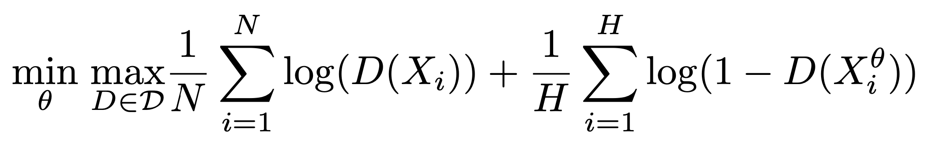
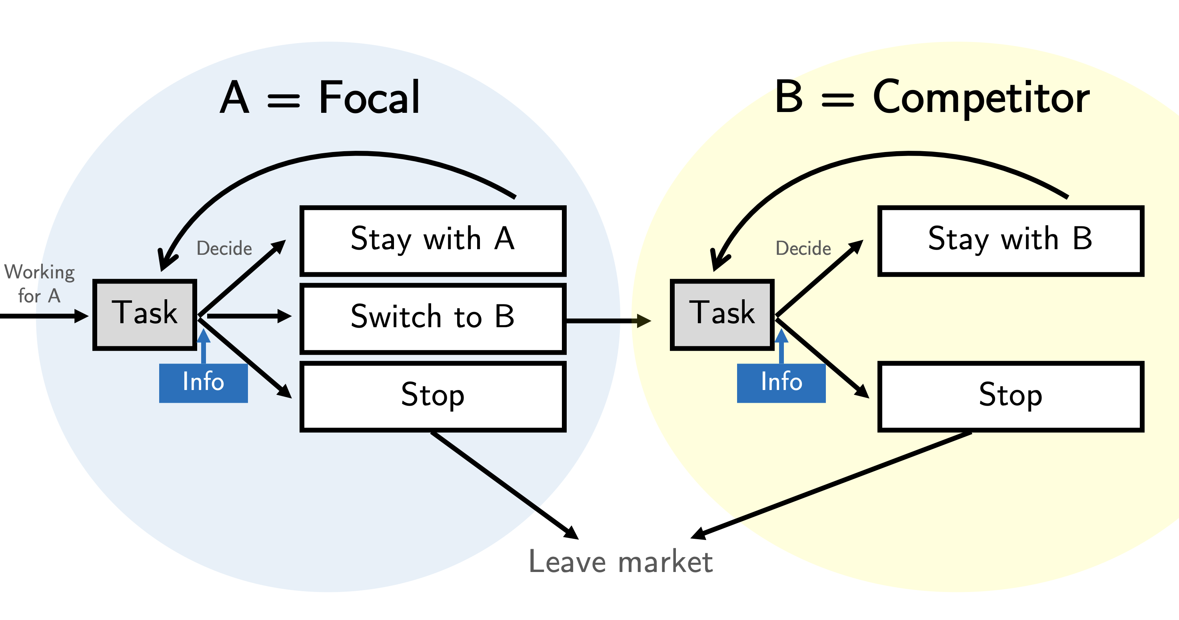

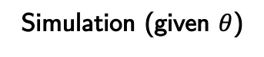
Kaji, Manresa & Pouliot (2020)
Adversarial Estimation
Real Data
Simulated Data
Data
“D”
X
Quitting Hour
Simulated
Y = 0
Quitting location
Y = 1
Simulation (given $θ$)
Quitting Hour
X
“G” = structural model
Quitting location
implementation
Notes:
So these real faces are like our actual data. [CLICK]
And generated faces are like our simulation output. [CLICK]
Here we adopt an approach called Adversarial Estimation recently proposed by Kaji et al.
One player is a discriminator “D” that looks the data and determines whether the data is real or simulated. Like the original GAN, We choose NN that gives us the probability that X is drawn from the real data.
The other player is a generator “G” that produces simulated data and is trained to confuse the discriminator.
We use our structural model that we want to estimate as G.
How do we define this estimator. ?
Our neural network is specified with a three-unit dense layer followed by a batch normalization and the leakyReLu activation function. We use a dropout rate of 40% between the first and the second block of dense. The dense, batch normalization, leakyReLu, and dropout pattern are repeated for three hidden layers before the last sigmoid output later. These are trained with a batch size of 32. To train the generator network, we use the gradient from the discriminator model to back-propagate through the cost function, and this allows us to calculate the gradient with respect to our parameters at the end of each iteration. Additionally, a soft labeling technique is implemented, to increase the stability of our GAN adaptation. To prevent the discriminator from overfitting, its weights are reinitialized when a gradient explosion occurs. We use the tensorflow and keras packages in R and the default Adam optimization algorithm for our implementation. After we train Dˆ using X and Xθ, we then fit it back to the same inputs to predict the labels Yˆ. We consider a cross-entropy loss function:
It is the solution to the min-max problem.
We will have the inner maximization problem for the accuracy measure. When we show a particular data X it gives us D(x) = P(X drawn from real). So it is the maximum-likelihood estimator of the discriminator model.
Then for that level of accuracy, the outer minimization problem looks for the parameter values for which real and simulated data are indistinguishable.
[NEXT]
Kaji et al 2020 provides theoretical guarantees and characterizes the statistical properties of a GAN-based estimator. In particular, the estimator has the same asymptotic distribution to the optimally weighted simulated method of moments.
The loss/objective function is minimized when simulated and real data are indistinguishable. To avoid overfitting, do out-of-sample accuracy.
If I want to find the best discriminator for real vs simulated, then I can go and use MLE to do this.
Interpretation: we use REAL and SIMULATED data to fit a discriminator that predicts the provenance of the data.
Think of this as minimum distance estimator, with the distance of the real vs simulated data Induced by the choice of the discriminator.
Data-driven way to choose distance!
Our neural network is specified with a three-unit dense layer followed by a batch normalization and the leakyReLu activation function. We use a dropout rate of 40% between the first and the second block of dense. The dense, batch normalization, leakyReLu, and dropout pattern are repeated for three hidden layers before the last sigmoid output later. These are trained with a batch size of 32. To train the generator network, we use the gradient from the discriminator model to back-propagate through the cost function, and this allows us to calculate the gradient with respect to our parameters at the end of each iteration. Additionally, a soft labeling technique is implemented, to increase the stability of our GAN adaptation. To prevent the discriminator from overfitting, its weights are reinitialized when a gradient explosion occurs. We use the tensorflow and keras packages in R and the default Adam optimization algorithm for our implementation. After we train Dˆ using X and Xθ, we then fit it back to the same inputs to predict the labels Yˆ. We consider a cross-entropy loss function:

Slide 53
Kaji, Manresa & Pouliot (2020)
Adversarial Estimation
The estimator is the solution to min-max problem:
Framework:
Inner maximization = MLE of the discriminator D
Outer minimization = push the model to find values for which real and simulated data are similar
Real Data
Simulated Data
Real Data
Simulated Data
…
…
X₁
X_{T}
X_{1,s}
X_{T,S}
_{labels}
1
…
1
0
…
0
Notes:
It is the solution to the min-max problem.
We will have the inner maximization problem for the accuracy measure. When we show a particular data X it gives us D(x) = P(X drawn from real). So it is the maximum-likelihood estimator of the discriminator model.
Then for that level of accuracy, the outer minimization problem looks for the parameter values for which real and simulated data are indistinguishable.
[NEXT]
Kaji et al 2020 provides theoretical guarantees and characterizes the statistical properties of a GAN-based estimator. In particular, the estimator has the same asymptotic distribution to the optimally weighted simulated method of moments.
The loss/objective function is minimized when simulated and real data are indistinguishable. To avoid overfitting, do out-of-sample accuracy.
If I want to find the best discriminator for real vs simulated, then I can go and use MLE to do this.
Interpretation: we use REAL and SIMULATED data to fit a discriminator that predicts the provenance of the data.
Think of this as minimum distance estimator, with the distance of the real vs simulated data Induced by the choice of the discriminator.
Data-driven way to choose distance!
Our neural network is specified with a three-unit dense layer followed by a batch normalization and the leakyReLu activation function. We use a dropout rate of 40% between the first and the second block of dense. The dense, batch normalization, leakyReLu, and dropout pattern are repeated for three hidden layers before the last sigmoid output later. These are trained with a batch size of 32. To train the generator network, we use the gradient from the discriminator model to back-propagate through the cost function, and this allows us to calculate the gradient with respect to our parameters at the end of each iteration. Additionally, a soft labeling technique is implemented, to increase the stability of our GAN adaptation. To prevent the discriminator from overfitting, its weights are reinitialized when a gradient explosion occurs. We use the tensorflow and keras packages in R and the default Adam optimization algorithm for our implementation. After we train Dˆ using X and Xθ, we then fit it back to the same inputs to predict the labels Yˆ. We consider a cross-entropy loss function:

Slide 54
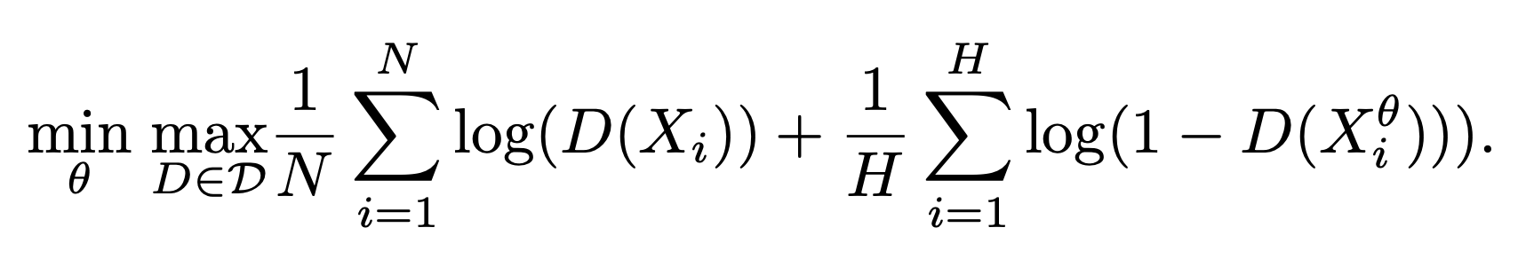
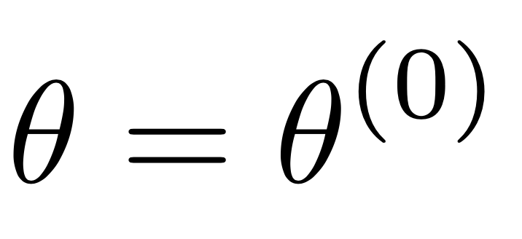
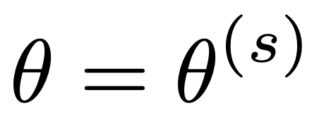
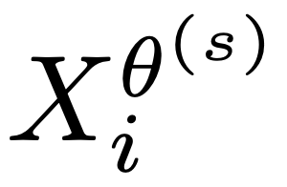
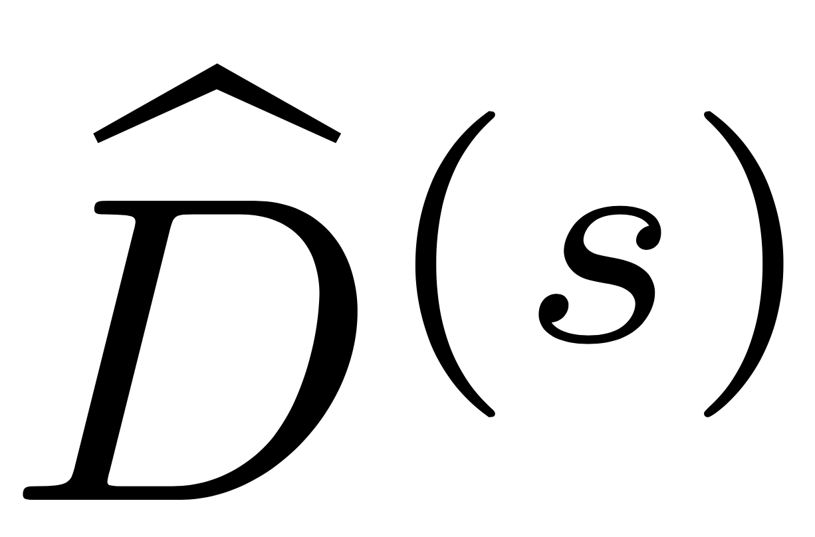
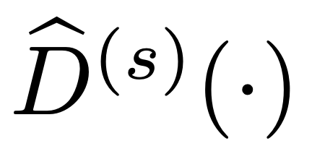
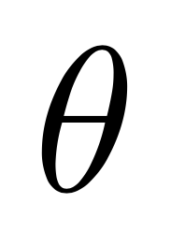
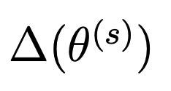
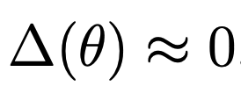
Implementation
“Cross-Entropy Loss”
Real Data
Simulated Data
Start with random initial
For , use our model to obtain
Solve inner maximization to obtain
Given , compute numerical gradients of loss w.r.t.
Repeat until convergence
Simulated Data
NN with 3 hidden layers + sigmoid activation
Notes:
[To implement this, we start with random initial set of theta. With this theta, we tap into our simulation machine to obtain the simulated data. Adding the actual data to the mix, we can then solve the inner maximization to obtain our discriminator. ]
We use a NN with 3 hidden layers. NN is known to perform really well in terms of classification accuracy and it can also turn large data into into lower dimensional problem, which is pretty attractive when we have a structural model with substantial heterogeneity. (large dimensional Xi)
Given this discriminator, we can compute numerical gradients of loss with respect to our parameter. These gradients give us where we should evaluate next. We repeat this process until convergence.
[13 minutes = need to rush!]
Our neural network is specified with a three-unit dense layer followed by a batch normalization and the leakyReLu activation function. We use a dropout rate of 40% between the first and the second block of dense. The dense, batch normalization, leakyReLu, and dropout pattern are repeated for three hidden layers before the last sigmoid output later. These are trained with a batch size of 32. To train the generator network, we use the gradient from the discriminator model to back-propagate through the cost function, and this allows us to calculate the gradient with respect to our parameters at the end of each iteration. Additionally, a soft labeling technique is implemented, to increase the stability of our GAN adaptation. To prevent the discriminator from overfitting, its weights are reinitialized when a gradient explosion occurs. We use the tensorflow and keras packages in R and the default Adam optimization algorithm for our implementation. After we train Dˆ using X and Xθ, we then fit it back to the same inputs to predict the labels Yˆ. We consider a cross-entropy loss function:

Slide 55
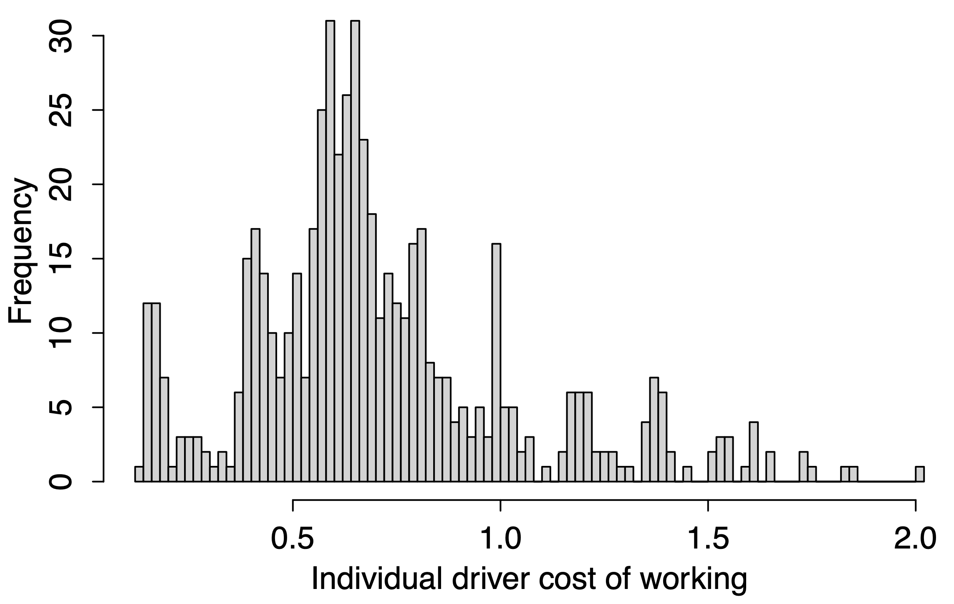
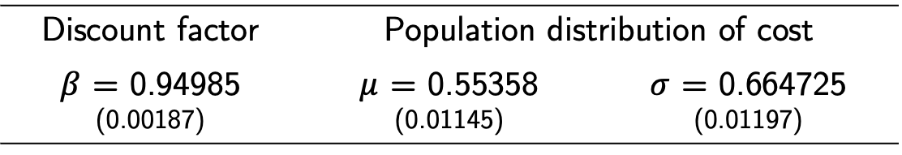
Estimation Results
Discount factor | Population distribution of cost
$β$ = 0.94985 (0.00187) | $μ$ = 0.55358 (0.01145) | $σ$ = 0.664725 (0.01197)
$1 in 2 hours
→ 73 cents now
Low-cost
High-cost
UWS, LWS, Brooklyn
JFK Airport
Notes:
Now let’s take a look at our result. The final set of theta includes the discount factor beta which we estimated to be 0.92.
With these estimates, we can then compute the average cost for each individual driver [CLICK] conditional on their decisions we observed. So here is the distribution of the cost.
We observe 2 pretty distinct groups, so I’ll call them as Low-Cost vs High-cost. The mixes of vehicle types are similar, but they differ in the locations they start working for the day.
Via mostly in Manhattan
Get paid to go there using Uber (another platform) -> Downtown/Midtown
Queens – Brooklyn start from home
UWS/LWS coming in from Jersey
UES, Harlem, LES always popular

Slide 56
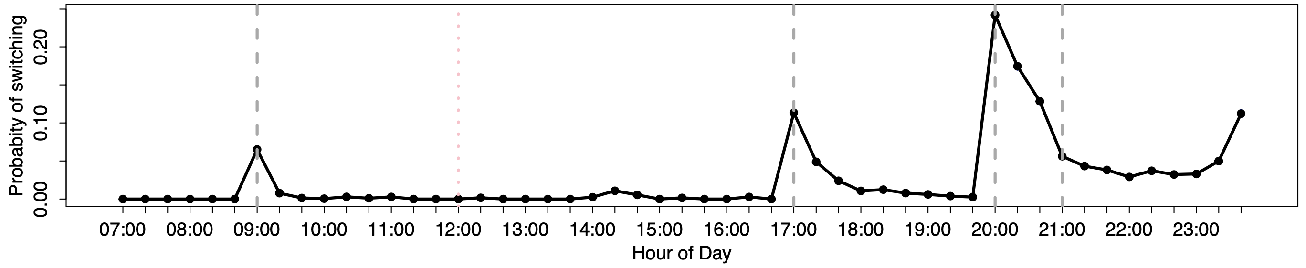
1
2
3
sum
Estimation Results
Discount factor | Population distribution of cost
$β$ = 0.94985 (0.00187) | $μ$ = 0.55358 (0.01145) | $σ$ = 0.664725 (0.01197)
66.59% most days
16.01% never
Fraction of workdays multihoming
42.23% always
P(switching to B) on average weekday
Hourly rate changes
Hourly rate changes
Hourly rate changes
Hourly rate changes

Slide 57
Multihoming
Good or Bad?
Workers spend less time idling. (Liu, Loginova & Wang 2017, Bryan & Gans 2018)
Workers work more but earn less. (Benjaafar, Xiao & Yang 2020)
How to control multihoming?
https://www.theverge.com/2018/8/8/17661374/uber-lyft-nyc-cap-vote-city-council-new-york-taxi
Notes:
A couple recent theoretical works show that it’s good because workers spend less time idling.
But another found that yes they work more but they also earn less.
It’s also bad for the firm given some cities like NYC, put a cap on the number of drivers. So multihoming means workers spend less fraction of their time working for you.
So here the goal is to Manage/Control multihoming.
[NEXT]

Slide 58
1
2
3
sum
Counterfactuals
Control Multihoming
Firm’s Policies
City’s Regulations
Impact of minimum wage policy on drivers’ earnings and utilization
Case Study: NYC 2018
Long-term Capacity
Optimal pay scheme
Short-term Capacity
Bonuses and delays
1
3
2

Slide 59
1
2
3
sum
Counterfactuals
Control Multihoming
Firm’s Policies
City’s Regulations
Impact of minimum wage policy on drivers’ earnings and utilization
Case Study: NYC 2018
Long-term Capacity
Optimal pay scheme
Short-term Capacity
Bonuses and delays
1
3
Pay per work 25-50% more costly to maintain work
2
Different policies for different demand situations
One policy for all hurts (lower earnings, higher idleness)

Slide 60
Counterfactuals
Control Multihoming
Firm’s Policies
City’s Regulations
Impact of minimum wage policy on drivers’ earnings and utilization
Case Study: NYC 2018
Long-term Capacity
Optimal pay scheme
Short-term Capacity
Bonuses and delays
1
3
Pay per work 25-50% more costly to maintain work
2
Different policies for different demand situations
One policy for all hurts (lower earnings, higher idleness)

Slide 61




1
2
3
sum
1
Firm’s Policies
Managing Long-Term
Pay per Work
Dynamic Guaranteed Pay
Workers compensated for each work they performed (e.g., each rider trip)
Workers guaranteed a fixed rate of hourly compensation during the shifts as long as they stay online
Notes:
From the firm’s perspective, this policy transparently reflects the market conditions of supply and demand. Because workers are compensated based on the work that they actually perform, they seek to become available when jobs are available and not when work is scarce. This allows the firm to be fluid and respond quickly to real-time changes in demand (and supply).
However, this policy requires workers to constantly check the availability of jobs, and the platform might not be able to attract workers in time for surges in demand. From the workers’ perspective, when the utilization rate is low, the idle time they spend waiting for work is costly and encourages them to multihome or find better alternatives.
Second scheme, workers are guaranteed a fixed rate of hourly compensation during their shifts as long as they are actively available for work on the platform. Our focal company as well as the grocery delivery platforms GoPuff and Postmates are examples of platforms offering a dynamic hourly wage. This policy allows the firm to be more certain about its costs while attracting more loyal workers. DeVoe and Pfeffer (2007) has empirically shown that the certainty of incentives (through guaranteed hourly wages) can increase worker productivity and induce them to work for a longer period of time.
When demand is unexpectedly low, however, the supply of workers may not adjust despite low utilization. Even when they are not serving customers, workers stay based on their guaranteed compensation. Unlike pay per work, however, the firm bears the costs of mismatched supply. Furthermore, the segment of workers it attracts may be limited, e.g., only those who are averse to income uncertainty. We investigate this by estimating the frequency at which each worker stays working for the focal platform.

Slide 62
1
2
3
sum
1
Firm’s Policies
Managing Long-Term
Pay per Work
Dynamic Guaranteed Pay
Workers compensated for each work they performed (e.g., each rider trip)
Workers guaranteed a fixed rate of hourly compensation during the shifts as long as they stay online
How much should Pay per Work be to match outcomes of Guaranteed Pay (Base)?
Notes:
From the firm’s perspective, this policy transparently reflects the market conditions of supply and demand. Because workers are compensated based on the work that they actually perform, they seek to become available when jobs are available and not when work is scarce. This allows the firm to be fluid and respond quickly to real-time changes in demand (and supply).
However, this policy requires workers to constantly check the availability of jobs, and the platform might not be able to attract workers in time for surges in demand. From the workers’ perspective, when the utilization rate is low, the idle time they spend waiting for work is costly and encourages them to multihome or find better alternatives.
Second scheme, workers are guaranteed a fixed rate of hourly compensation during their shifts as long as they are actively available for work on the platform. Our focal company as well as the grocery delivery platforms GoPuff and Postmates are examples of platforms offering a dynamic hourly wage. This policy allows the firm to be more certain about its costs while attracting more loyal workers. DeVoe and Pfeffer (2007) has empirically shown that the certainty of incentives (through guaranteed hourly wages) can increase worker productivity and induce them to work for a longer period of time.
When demand is unexpectedly low, however, the supply of workers may not adjust despite low utilization. Even when they are not serving customers, workers stay based on their guaranteed compensation. Unlike pay per work, however, the firm bears the costs of mismatched supply. Furthermore, the segment of workers it attracts may be limited, e.g., only those who are averse to income uncertainty. We investigate this by estimating the frequency at which each worker stays working for the focal platform.

Slide 63
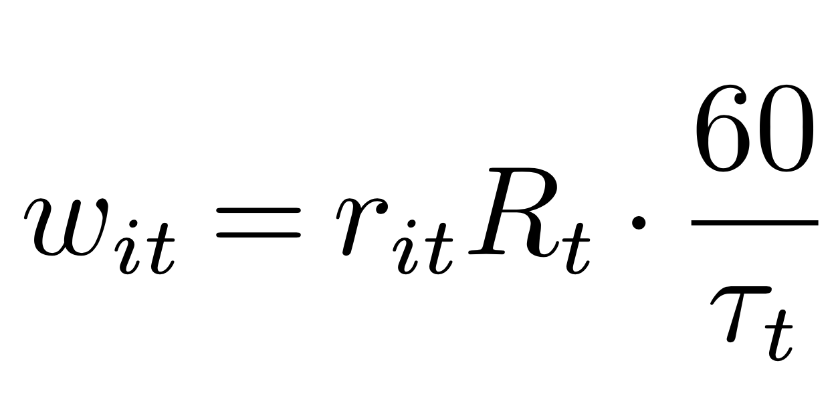
1
2
3
sum
1
Firm’s Policies
Managing Long-Term
Pay per Work
Dynamic Guaranteed Pay
Workers compensated for each work they performed (e.g., each rider trip)
Workers guaranteed a fixed rate of hourly compensation during the shifts as long as they stay online
How much should Pay per Work be to match outcomes of Guaranteed Pay (Base)?
Pay per work
“1x” rate
Dynamic guaranteed hourly rate
Average trip duration
P(getting a match)
Notes:
From the firm’s perspective, this policy transparently reflects the market conditions of supply and demand. Because workers are compensated based on the work that they actually perform, they seek to become available when jobs are available and not when work is scarce. This allows the firm to be fluid and respond quickly to real-time changes in demand (and supply).
However, this policy requires workers to constantly check the availability of jobs, and the platform might not be able to attract workers in time for surges in demand. From the workers’ perspective, when the utilization rate is low, the idle time they spend waiting for work is costly and encourages them to multihome or find better alternatives.
Second scheme, workers are guaranteed a fixed rate of hourly compensation during their shifts as long as they are actively available for work on the platform. Our focal company as well as the grocery delivery platforms GoPuff and Postmates are examples of platforms offering a dynamic hourly wage. This policy allows the firm to be more certain about its costs while attracting more loyal workers. DeVoe and Pfeffer (2007) has empirically shown that the certainty of incentives (through guaranteed hourly wages) can increase worker productivity and induce them to work for a longer period of time.
When demand is unexpectedly low, however, the supply of workers may not adjust despite low utilization. Even when they are not serving customers, workers stay based on their guaranteed compensation. Unlike pay per work, however, the firm bears the costs of mismatched supply. Furthermore, the segment of workers it attracts may be limited, e.g., only those who are averse to income uncertainty. We investigate this by estimating the frequency at which each worker stays working for the focal platform.

Slide 64
1
2
3
sum
1
Firm’s Policies
Managing Long-Term
Pay per Work
Dynamic Guaranteed Pay
Workers compensated for each work they performed (e.g., each rider trip)
Workers guaranteed a fixed rate of hourly compensation during the shifts as long as they stay online
How much should Pay per Work be to match outcomes of Guaranteed Pay (Base)?
Pay per work
“1x” rate
Dynamic guaranteed hourly rate
Average trip duration
P(getting a match)
“_x” rate = multiplier of 1x
Notes:
From the firm’s perspective, this policy transparently reflects the market conditions of supply and demand. Because workers are compensated based on the work that they actually perform, they seek to become available when jobs are available and not when work is scarce. This allows the firm to be fluid and respond quickly to real-time changes in demand (and supply).
However, this policy requires workers to constantly check the availability of jobs, and the platform might not be able to attract workers in time for surges in demand. From the workers’ perspective, when the utilization rate is low, the idle time they spend waiting for work is costly and encourages them to multihome or find better alternatives.
Second scheme, workers are guaranteed a fixed rate of hourly compensation during their shifts as long as they are actively available for work on the platform. Our focal company as well as the grocery delivery platforms GoPuff and Postmates are examples of platforms offering a dynamic hourly wage. This policy allows the firm to be more certain about its costs while attracting more loyal workers. DeVoe and Pfeffer (2007) has empirically shown that the certainty of incentives (through guaranteed hourly wages) can increase worker productivity and induce them to work for a longer period of time.
When demand is unexpectedly low, however, the supply of workers may not adjust despite low utilization. Even when they are not serving customers, workers stay based on their guaranteed compensation. Unlike pay per work, however, the firm bears the costs of mismatched supply. Furthermore, the segment of workers it attracts may be limited, e.g., only those who are averse to income uncertainty. We investigate this by estimating the frequency at which each worker stays working for the focal platform.

Slide 65
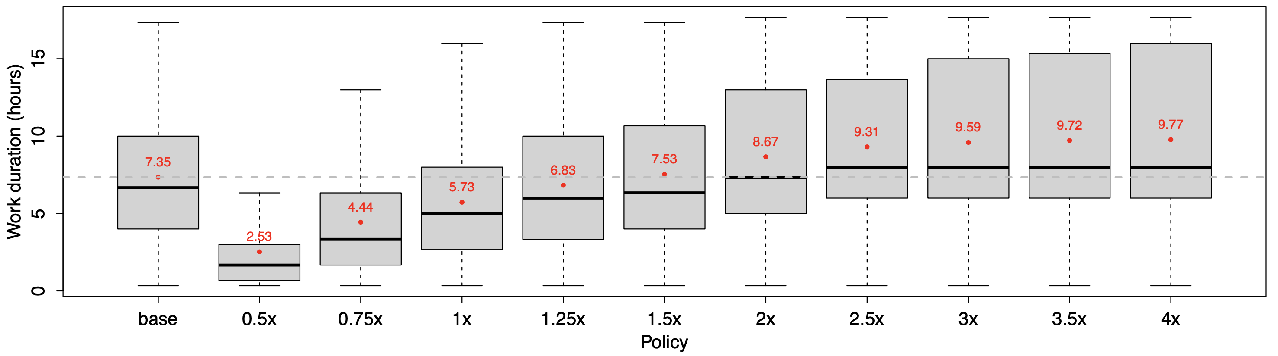
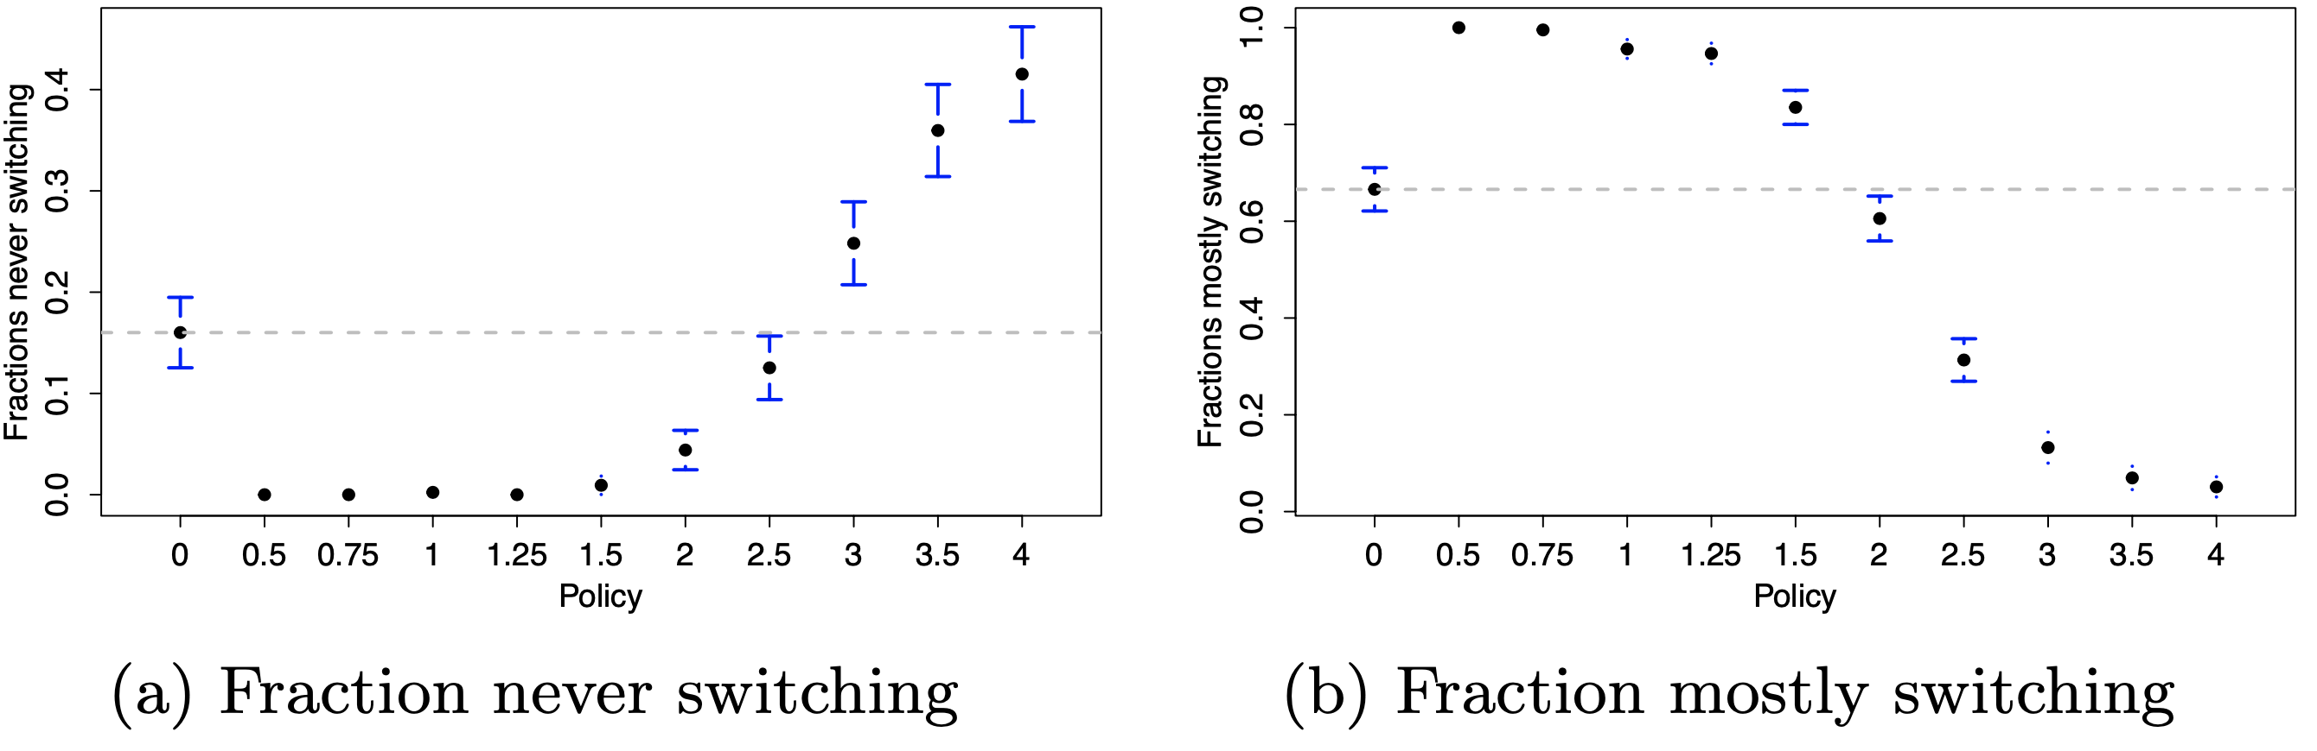
1
2
3
sum
1
Pay Schemes
Need 1.25-1.5x pay per work rate to match work duration of guaranteed pay
Work Duration (hours)
Guaranteed Pay
Pay per Work
Base
2.5-3x to keep most loyal workers
1.5-2x to keep those who switch 50%+
Guaranteed Pay
Guaranteed Pay
Pay per Work
Pay per Work
Base
Base
Notes:
Note that the regular pay-per-trip policy (1×) generally leads to a shorter work duration on the focal platform (22.04%). It would require the platform to increase the scaling factor between 1.25× and 1.5× in order to match the work duration under the base policy.
suggests the first benefit of the guaranteed pay: the firm can induce the workers to work for the same duration at a lower cost if the firm guarantees the earnings regardless of the number of trips.
Drivers who never switch to the competing platform when working for the focal firm can be considered as the most loyal group. We find that, to keep the same fraction of these loyal drivers as when offering the guaranteed pay, the pay-per-trip rate has be between 2.5× and 3× of the current hourly offer (see Figure 7a). In other words, a guaranteed pay scheme could save the platform up to 75% of the cost to maintain the same level of loyal drivers pool. Similarly, to keep the same fraction of drivers who switch most of the times, the pay-per-trip rate has to be between 1.5× and 2× (see Figure 7b).

Slide 66
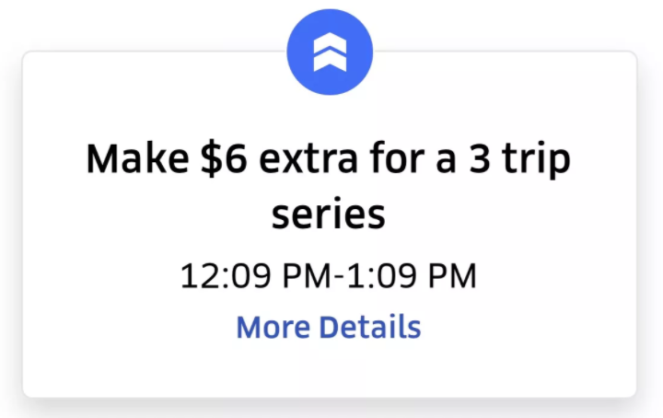
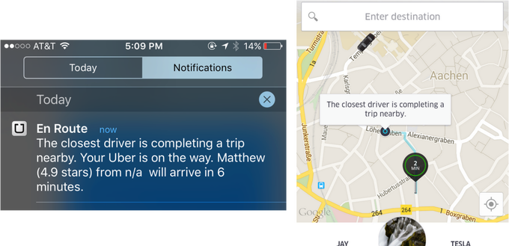
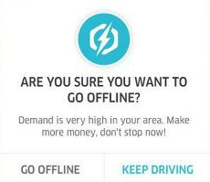
1
2
3
sum
2
Firm’s Policies
Managing Short-Term
Consecutive Work Bonus
Time Delay
Make it costlier to switch
Time lag before being able to leave
Penalty fee if switching <- compute what the fee would be, turn it into a bonus that driver won’t get.
Bonus if staying longer
Route drivers that are less prone to multihoming to strategic locations
Need to work full hour to get hourly offer
Need to wait 20 mins Still getting paid work
~ harder to quit/imposing a supply cap
~ consecutive trips bonus
Notes:
A very common policy is to provide incentives for consecutive work like this one example from Uber.
So we consider the first policy [CLICK] which is a bit more extreme where workers need to stay online for one hour to get paid for that hour.
This policy seems to essentially keep people long, unconditionally. Nudge them to only quit at the hour. Less opportunity to quit, especially for those high cost drivers who want to quit.
Another policy is a time delay where workers need to request that they want to leave ahead of time, like 20 minutes. During those times, they might still get one last assignment.
This is similar to how Uber assigns trips back to back, or for some other apps drivers have to click multiple buttons until they can finally quit.
This policy should also keep drivers longer than before When it’s busier, more likely to do one more job.
So one key difference here is that it its effect seems to be more conditional on the state of the system.
[NXT]
SHORT-TERM CAPACITY
Given that multihoming happens in most markets, there is the question of how platforms can best manage its occurrence. Ideally, platforms would like to keep workers active at working to lower the chance of them switching over to their competitors. Here are the Two common levers:
Platforms usually offer bonuses if workers complete a required number of jobs consecutively or staying active for a minimum amount of time. Today I'm showing you a more extreme version where workers need to stay online for one hour to get the bonuses for that hour.
This policy seems to essentially keep people long, unconditionally. Nudge them to only quit at the hour. Less opportunity to quit.
Another policy is imposing frictions or time delay to slow workers who are considering leaving. Workers need to request that they want to leave ahead of time, like 20 minutes. During those times, they might still get one last assignment.
This is similar to how Uber assigns trips back to back, or for some other apps drivers have to click multiple buttons until they can finally quit.
This policy should also keep drivers longer than before
When it’s busier, more likely to do one more job so they get to leave a bit later than they wish. When it's not busy, then when after a set amount of time they can leave.
So one key difference here is that it its effect seems to be more conditional on the state of the system.
Talk about it, pose as a question (no need to do formal table)
Set up for next slide.
The main difference in some ways -> state dependence (how they handle how busy the system is)
What would affect HC more?
1: Less opportunity to quit (for LU HC who wanna quit), the utilization gap will be smaller
2: more effect of switching for LC, cannot switch immediately
Trciky when they wanna switch but it’s busy on Via
(interesting cuz I think about dislike idleness earlier)

Slide 67
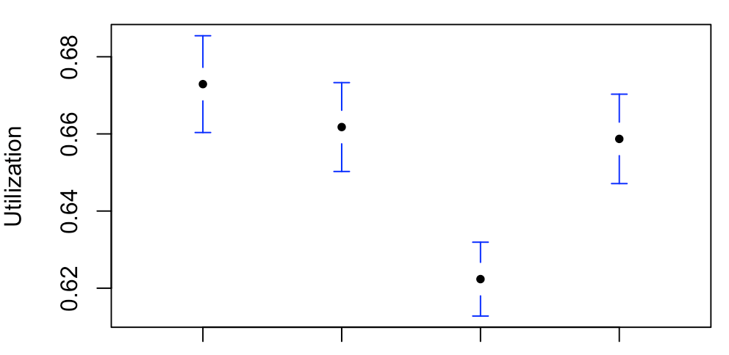
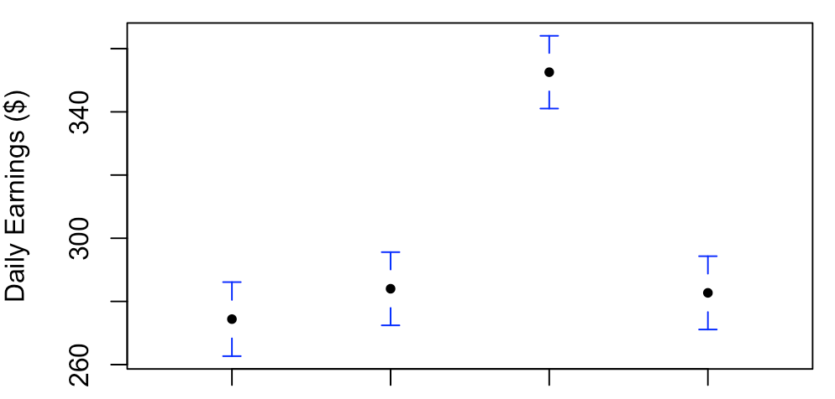
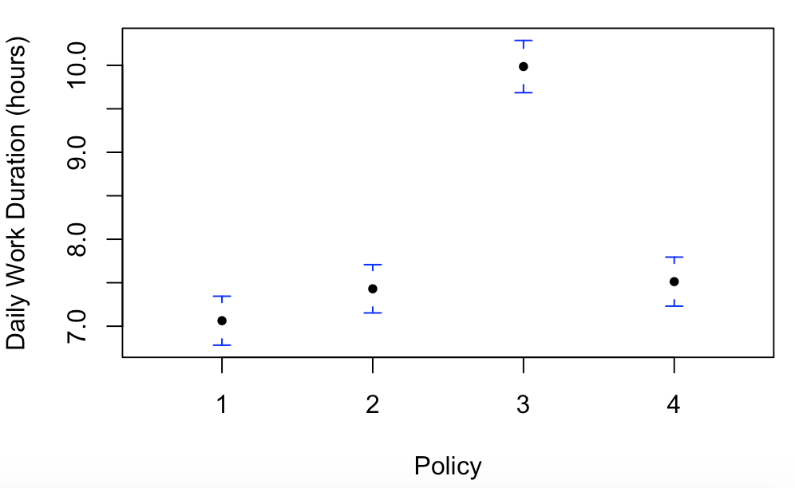
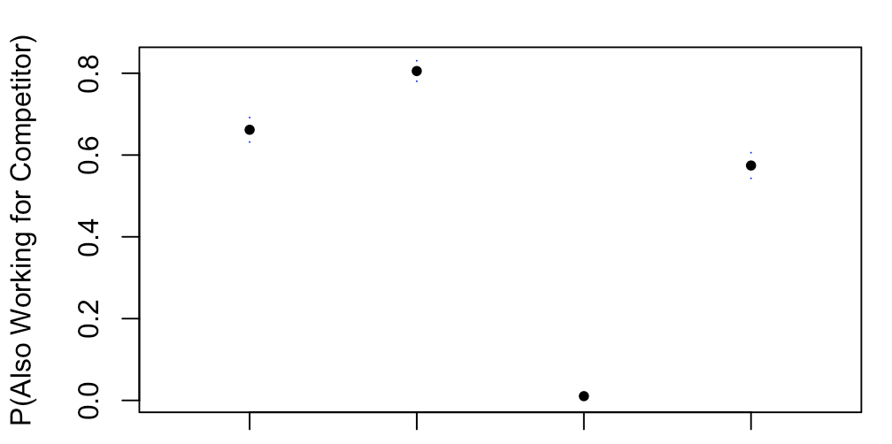
1
2
3
sum
2
Firm’s Policies
Managing Short-Term
Daily Utilization
Daily Earnings
Base Delay Cons. Bonus
Base Delay Cons. Bonus
Daily Work Duration
P(Multihoming)
Base Delay Cons. Bonus
Base Delay Cons. Bonus
Notes:
So first we saw that overall utilization drops with these policies though not too much…
while workers earn more on average on the system. [CLICK]
Looking at work duration, all 2 policies induce workers to work for a longer time.
Since stay longer, on average it makes sense that utilization has to go down
We can also look at how likely the worker would switch to the competitor. [CLICK]
At the baseline, it’s quite high already. [CLICK]
The consecutive bonus policy helps reduce the switching probability as expected. When you want to switch, when it’s a great time on other platform, if you can only switch once every hour, you’re less likely to switch. Especially for high cost drivers, you don’t want to forgo the pay. [CLICK]
Now, for the delay policy that we thought could also keep drivers longer by assigning an extra trip. It actually increases the switching probability.
Recall that when you want to quit, you need to wait 20 minutes. If it is during busy hours, you might get another trip that takes longer than 20 minutes so you end up leaving even later than expected. This could nudge people to switch before things get busy again.
During low demand period, it also keeps drivers in the low demand region for a longer time. So it might be better for drivers to switch out early rather being stuck for 20 more minutes.
These results suggest potential polices that the platforms can employ at different demand period. [CLICK]
During peak hours when you want workers to stay with you longer, offering consecutive work bonus is pretty effective. In a way it creates a goal for the workers and people love following goals. [CLICK]
But when there's not a lot of demand and you don't want to keep workers idling, a simple intervention like adding a time delay when workers want to quit could nudge them to quit sooner.
For those stuck
Switch before it gets busy again
Don’t want to stay in low demand region too long ( hate idling)
Time delay would have done well to keep people during peak hours, but 20 minutes or 1 trip is not enough.
We found that during peak hours when you want workers to stay with you longer, offering consective work bonus is pretty effective. In a way it creates a goal for the workers and people love following goals.
click
But when there's not a lot of demand and you don't want to keep workers idling, a simple intervention like adding a time delay when workers want to quit, actually nudges them to quit earlier. This can be because people view idling as even worse if they have to stick around a bit longer.
Delay keeps people when it’s busier, so it’s high than bonus
Trade off/ b/w utilization.
When we artificially make people stay, automatically keeping people more even it’s not busy.
Wheter ti quit VS busy or not.
Why does delay increase?
Switch before it gets busy again
Don’t want to stay in low demand region too long ( hate idling)
Reverse one intuition from before
Time delay would have done well to keep people during peak hours, but 20 minutes or 1 trip is not enough.
If we can better explain that “DELAY INCREASES SWITCHING” it would be nice! State dependence -> build that into presentation.
(FUTURE: do the plot conditional on demand)

Slide 68
1
2
3
sum
2
Firm’s Policies
Managing Short-Term
Daily Utilization
Daily Earnings
Base Delay Cons. Bonus
Base Delay Cons. Bonus
Daily Work Duration
P(Multihoming)
Base Delay Cons. Bonus
Base Delay Cons. Bonus
Notes:
So first we saw that overall utilization drops with these policies though not too much…
while workers earn more on average on the system. [CLICK]
Looking at work duration, all 2 policies induce workers to work for a longer time.
Since stay longer, on average it makes sense that utilization has to go down
We can also look at how likely the worker would switch to the competitor. [CLICK]
At the baseline, it’s quite high already. [CLICK]
The consecutive bonus policy helps reduce the switching probability as expected. When you want to switch, when it’s a great time on other platform, if you can only switch once every hour, you’re less likely to switch. Especially for high cost drivers, you don’t want to forgo the pay. [CLICK]
Now, for the delay policy that we thought could also keep drivers longer by assigning an extra trip. It actually increases the switching probability.
Recall that when you want to quit, you need to wait 20 minutes. If it is during busy hours, you might get another trip that takes longer than 20 minutes so you end up leaving even later than expected. This could nudge people to switch before things get busy again.
During low demand period, it also keeps drivers in the low demand region for a longer time. So it might be better for drivers to switch out early rather being stuck for 20 more minutes.
These results suggest potential polices that the platforms can employ at different demand period. [CLICK]
During peak hours when you want workers to stay with you longer, offering consecutive work bonus is pretty effective. In a way it creates a goal for the workers and people love following goals. [CLICK]
But when there's not a lot of demand and you don't want to keep workers idling, a simple intervention like adding a time delay when workers want to quit could nudge them to quit sooner.
For those stuck
Switch before it gets busy again
Don’t want to stay in low demand region too long ( hate idling)
Time delay would have done well to keep people during peak hours, but 20 minutes or 1 trip is not enough.
We found that during peak hours when you want workers to stay with you longer, offering consective work bonus is pretty effective. In a way it creates a goal for the workers and people love following goals.
click
But when there's not a lot of demand and you don't want to keep workers idling, a simple intervention like adding a time delay when workers want to quit, actually nudges them to quit earlier. This can be because people view idling as even worse if they have to stick around a bit longer.
Delay keeps people when it’s busier, so it’s high than bonus
Trade off/ b/w utilization.
When we artificially make people stay, automatically keeping people more even it’s not busy.
Wheter ti quit VS busy or not.
Why does delay increase?
Switch before it gets busy again
Don’t want to stay in low demand region too long ( hate idling)
Reverse one intuition from before
Time delay would have done well to keep people during peak hours, but 20 minutes or 1 trip is not enough.
If we can better explain that “DELAY INCREASES SWITCHING” it would be nice! State dependence -> build that into presentation.
(FUTURE: do the plot conditional on demand)

Slide 69
1
2
3
sum
2
Firm’s Policies
Managing Short-Term
Daily Utilization
Daily Earnings
Base Delay Cons. Bonus
Base Delay Cons. Bonus
Daily Work Duration
P(Multihoming)
Base Delay Cons. Bonus
Base Delay Cons. Bonus
Peak Hours
Low Demand
Consecutive Work Bonus
Time Delay
Notes:
So first we saw that overall utilization drops with these policies though not too much…
while workers earn more on average on the system. [CLICK]
Looking at work duration, all 2 policies induce workers to work for a longer time.
Since stay longer, on average it makes sense that utilization has to go down
We can also look at how likely the worker would switch to the competitor. [CLICK]
At the baseline, it’s quite high already. [CLICK]
The consecutive bonus policy helps reduce the switching probability as expected. When you want to switch, when it’s a great time on other platform, if you can only switch once every hour, you’re less likely to switch. Especially for high cost drivers, you don’t want to forgo the pay. [CLICK]
Now, for the delay policy that we thought could also keep drivers longer by assigning an extra trip. It actually increases the switching probability.
Recall that when you want to quit, you need to wait 20 minutes. If it is during busy hours, you might get another trip that takes longer than 20 minutes so you end up leaving even later than expected. This could nudge people to switch before things get busy again.
During low demand period, it also keeps drivers in the low demand region for a longer time. So it might be better for drivers to switch out early rather being stuck for 20 more minutes.
These results suggest potential polices that the platforms can employ at different demand period. [CLICK]
During peak hours when you want workers to stay with you longer, offering consecutive work bonus is pretty effective. In a way it creates a goal for the workers and people love following goals. [CLICK]
But when there's not a lot of demand and you don't want to keep workers idling, a simple intervention like adding a time delay when workers want to quit could nudge them to quit sooner.
For those stuck
Switch before it gets busy again
Don’t want to stay in low demand region too long ( hate idling)
Time delay would have done well to keep people during peak hours, but 20 minutes or 1 trip is not enough.
We found that during peak hours when you want workers to stay with you longer, offering consective work bonus is pretty effective. In a way it creates a goal for the workers and people love following goals.
click
But when there's not a lot of demand and you don't want to keep workers idling, a simple intervention like adding a time delay when workers want to quit, actually nudges them to quit earlier. This can be because people view idling as even worse if they have to stick around a bit longer.
Delay keeps people when it’s busier, so it’s high than bonus
Trade off/ b/w utilization.
When we artificially make people stay, automatically keeping people more even it’s not busy.
Wheter ti quit VS busy or not.
Why does delay increase?
Switch before it gets busy again
Don’t want to stay in low demand region too long ( hate idling)
Reverse one intuition from before
Time delay would have done well to keep people during peak hours, but 20 minutes or 1 trip is not enough.
If we can better explain that “DELAY INCREASES SWITCHING” it would be nice! State dependence -> build that into presentation.
(FUTURE: do the plot conditional on demand)

Slide 70
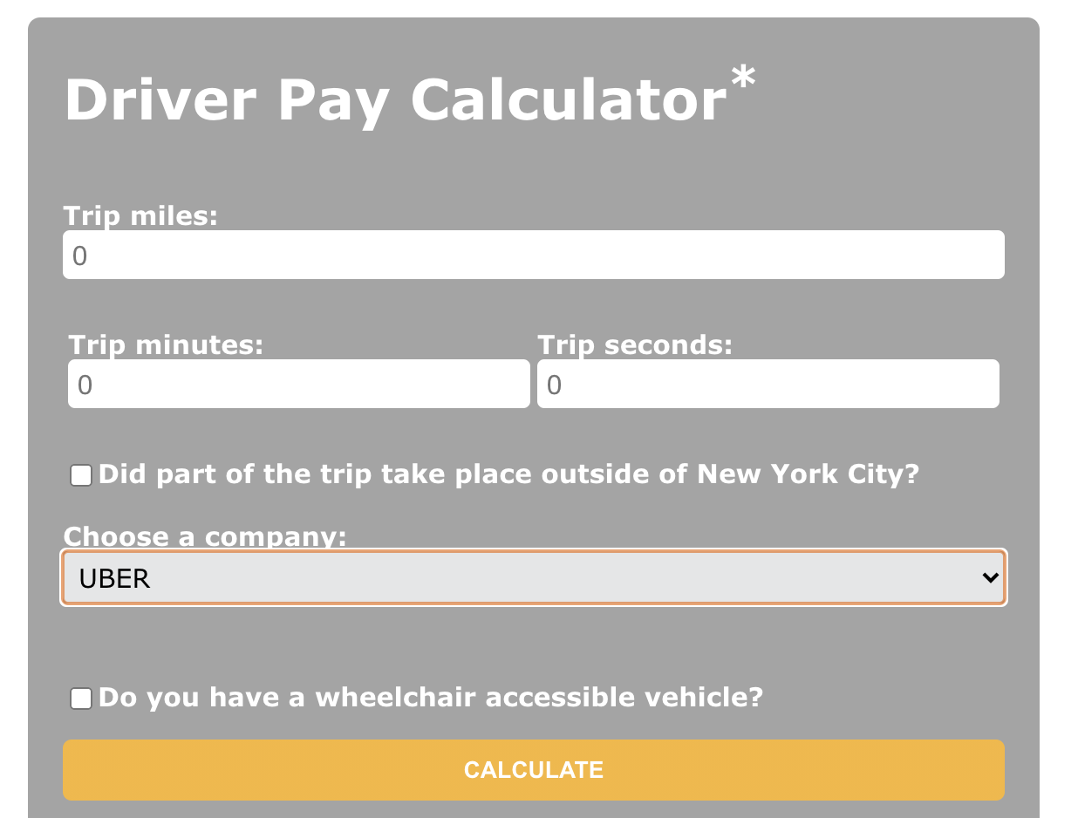
1
2
3
sum
Policy Analysis
Driver Income Rules
In December 2018, TLC launched new rules
Overall, drivers should earn $17.22+ per hour of working
Must be paid at least ($1.088 x miles + $0.495 x minutes)/trip
Notes:
Before, it’s $11.90/hour after expenses (NYC minimum wage was $13)
Our model is missing the fact that this will raise the price of service -> lower demand -> utilization level changes
Varying utilization.
Starting in February, ride-share companies have to reduce cruising rates by 5% and later by 10%, down from currently 41%.
Uber supported a $2.75 congestion surcharge implemented for Manhattan ride-share trips earlier this year.
Firms’ responses: Uber and Lyft restricted access (lock drivers out during some times / locations), Juno quitted.
Lyft “allow certain companies to pay drivers lower wages” “disincentive drivers from giving rides to and from areas outside NYC” “fewer rides, shorter and slower trips”
Uber “higher than necessary fares”
Feasible for loose labor market. If M is too high, firm will cap its supply. (Aradpour, Lobel, van Ryzin 2020)
From our prelim results, these results suggest that…
Use reduced form as a baseline. Spatial element. Heterogeneity in people.
Targeted different for different things.
Which policies work for which group?
Which locations?
SHOW THESE RESULTS WITH SPATIAL ELEMENTS

Slide 71
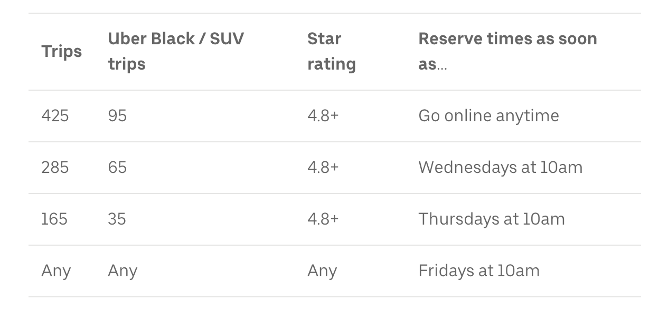
1
2
3
sum
Policy Analysis
Driver Income Rules
In December 2018, TLC launched new rules
Overall, drivers should earn $17.22+ per hour of working
Must be paid at least ($1.088 x miles + $0.495 x minutes)/trip
Uber and Lyft restricted access to some drivers.
Dynamic supply control needed to achieve high min wage (Aradpour, Lobel, van Ryzin 2020)
https://www.uber.com/blog/new-york-city/tlc-rule-changes/
Notes:
Our model is missing the fact that this will raise the price of service -> lower demand -> utilization level changes
Varying utilization.
Starting in February, ride-share companies have to reduce cruising rates by 5% and later by 10%, down from currently 41%.
Uber supported a $2.75 congestion surcharge implemented for Manhattan ride-share trips earlier this year.
Firms’ responses: Uber and Lyft restricted access (lock drivers out during some times / locations), Juno quitted.
Lyft “allow certain companies to pay drivers lower wages” “disincentive drivers from giving rides to and from areas outside NYC” “fewer rides, shorter and slower trips”
Uber “higher than necessary fares”
Feasible for loose labor market. If M is too high, firm will cap its supply. (Aradpour, Lobel, van Ryzin 2020)
From our prelim results, these results suggest that…
Use reduced form as a baseline. Spatial element. Heterogeneity in people.
Targeted different for different things.
Which policies work for which group?
Which locations?
SHOW THESE RESULTS WITH SPATIAL ELEMENTS

Slide 72
1
2
3
sum
Policy Analysis
Driver Income Rules
In December 2018, TLC launched new rules
Overall, drivers should earn $17.22+ per hour of working
Must be paid at least ($1.088 x miles + $0.495 x minutes)/trip
Uber and Lyft restricted access to some drivers.
Dynamic supply control needed to achieve high min wage (Aradpour, Lobel, van Ryzin 2020)
NYC: “Drivers expected to be paid extra $172 million first 4 months”
Drivers: “Not really. Too many drivers. Too much idle time.”
Fares not necessarily higher (3-5%) (Parrott, Reich 2018)
Notes:
Our model is missing the fact that this will raise the price of service -> lower demand -> utilization level changes
Varying utilization.
Starting in February, ride-share companies have to reduce cruising rates by 5% and later by 10%, down from currently 41%.
Uber supported a $2.75 congestion surcharge implemented for Manhattan ride-share trips earlier this year.
Firms’ responses: Uber and Lyft restricted access (lock drivers out during some times / locations), Juno quitted.
Lyft “allow certain companies to pay drivers lower wages” “disincentive drivers from giving rides to and from areas outside NYC” “fewer rides, shorter and slower trips”
Uber “higher than necessary fares”
Feasible for loose labor market. If M is too high, firm will cap its supply. (Aradpour, Lobel, van Ryzin 2020)
From our prelim results, these results suggest that…
Use reduced form as a baseline. Spatial element. Heterogeneity in people.
Targeted different for different things.
Which policies work for which group?
Which locations?
SHOW THESE RESULTS WITH SPATIAL ELEMENTS

Slide 73
1
2
3
sum
Policy Analysis
Driver Income Rules
Competitor adopting the rules?
No
No
Focal firm adopting the rules? (for their hourly-paid drivers)
“Pre-2019”
-13.5% switch
-16.8% switch
Notes:
From our prelim results, these results suggest that…
Use reduced form as a baseline. Spatial element. Heterogeneity in people.
Targeted different for different things.
Which policies work for which group?
Which locations?
SHOW THESE RESULTS WITH SPATIAL ELEMENTS

Slide 74
1
2
3
sum
Policy Analysis
Driver Income Rules
Competitor adopting the rules?
No
Yes
-3.5% $
+2.1% Idle
No
Focal firm adopting the rules? (for their hourly-paid drivers)
“Pre-2019”
“Current”
-13.5% switch
-16.8% switch
Notes:
From our prelim results, these results suggest that…
Use reduced form as a baseline. Spatial element. Heterogeneity in people.
Targeted different for different things.
Which policies work for which group?
Which locations?
SHOW THESE RESULTS WITH SPATIAL ELEMENTS

Slide 75
1
2
3
sum
Policy Analysis
Driver Income Rules
Competitor adopting the rules?
No
Yes
Drivers: “Not really. Too many drivers. Too much idle time.”
Fares not necessarily higher (3-5%) (Parrott, Reich 2018)
-3.5% $
+2.1% Idle
No
Focal firm adopting the rules? (for their hourly-paid drivers)
“Pre-2019”
“Current”
-13.5% switch
-16.8% switch
Notes:
From our prelim results, these results suggest that…
Use reduced form as a baseline. Spatial element. Heterogeneity in people.
Targeted different for different things.
Which policies work for which group?
Which locations?
SHOW THESE RESULTS WITH SPATIAL ELEMENTS

Slide 76
1
2
3
sum
Policy Analysis
Driver Income Rules
Competitor adopting the rules?
No
Yes
Drivers: “Not really. Too many drivers. Too much idle time.”
Fares not necessarily higher (3-5%) (Parrott, Reich 2018)
-3.5% $
+2.1% Idle
No
Focal firm adopting the rules? (for their hourly-paid drivers)
“Pre-2019”
“Current”
“Reverse”
“Universal”
Yes
+3% $
-1.2% $
+3.3% Idle
+7% Idle
-13.5% switch
-16.8% switch
Notes:
From our prelim results, these results suggest that…
Use reduced form as a baseline. Spatial element. Heterogeneity in people.
Targeted different for different things.
Which policies work for which group?
Which locations?
SHOW THESE RESULTS WITH SPATIAL ELEMENTS

Slide 77
1
2
3
sum
Policy Analysis
Driver Income Rules
Competitor adopting the rules?
No
Yes
Drivers: “Not really. Too many drivers. Too much idle time.”
Fares not necessarily higher (3-5%) (Parrott, Reich 2018)
-3.5% $
+2.1% Idle
No
Focal firm adopting the rules? (for their hourly-paid drivers)
“Pre-2019”
“Current”
“Reverse”
“Universal”
Yes
+3% $
-1.2% $
+3.3% Idle
+7% Idle
-13.5% switch
-16.8% switch
Notes:
From our prelim results, these results suggest that…
Use reduced form as a baseline. Spatial element. Heterogeneity in people.
Targeted different for different things.
Which policies work for which group?
Which locations?
SHOW THESE RESULTS WITH SPATIAL ELEMENTS

Slide 78

2
The Structural Behavioral Model of Gig Economy Workers
(with G. Allon, M. Cohen, and K. Moon, Work in Progress)
1
2
3
sum
Summary
Managing Multihoming Workers in the Gig Economy
Approach
Structural model of dynamic decisions
Work options depend on time/location, dynamic pay
ML-based simulation-assisted estimation: adversarial estimation
Findings
42% of drivers multihome
More likely to switch when pay rate changes/utilization is low
Guaranteed pay: save 25-50% from pay-per-work
Peak hours: consecutive work bonus to retain drivers
Low demand: add time delay to nudge earlier departure
Policy: better predict impact of new policy on workers
Next Steps
Extend to N outside work options
Allow for switching back and forth
Allow for non-zero time-dependent “home” option
Link back to income targeting and inertia
Thank you!
Read more:
bit.ly/ mmwpaper
Gad Allon, Maxime Cohen, Ken Moon, Park Sinchaisri (parksinchaisri@berkeley.edu)
Notes:
To summarize, understanding how workers make multihoming decisions is important for both the firm and the policymakers to design a better policy for all, but it's been hard to trace and study. We're hoping to close this gap by modeling workers’ sequential intra-day decisions structurally using machine learning and simulation-assisted estimation. Our model accounts for the detailed time and location of drivers’ decisions, the platform’s pay incentives, and the contemporaneous work conditions and compensation rates on the competing gig platform. Our prescriptive counterfactual analyses offer some new insights that could inform the gig platforms’ and policymakers.

